Slide 1

State of the stocks and European seas
Overfishing: past & present and iconic fish at risk
Valeska Diemel​
Fisheries Policy Officer​
Bund für Umwelt und Naturschutz Deutschland
Notes:
Hello, my name is Valeska Diemel and I‘m the fisheries policy officer of BUND, a German member organisation of Seas at Risk.
In the next couple of minutes I will run you through the current status of fish stocks in the North Sea / Atlantic and present to you in more detail the dramatic situation of one of our most iconic fish specis: The Atlantic cod.

Slide 2
Progress to end overfishing
Trends in stock status in the NE Atlantic (STECF, 2021*)
Overfished stocks and stocks outside safe biological limits have been slowly decreasing since 2005.
In 2019 there was an increase again!
Only 40% stocks are simultaneously not overfished and inside safe biological limits.
* Scientific, Technical and Economic Committee for Fisheries (STECF): Monitoring the performance of the Common Fisheries Policy. European Union, 2021.
Notes:
I we want to look at how the progress to end overfishing is going there are two important values we look at. The first values is the fishing pressure (how much fish is taken from the ocean by fisheries) ). If the fishing pressure is above the maximum sustainable value (FMSY) a stock is considered overfished.
The second value we look at is the biomass to assess if the stock has a healthy size and can reproduce sufficiently. If the biomass is below the critical reference point the stock is considered “outside safe biological limits”.
What you can see here is the trend in stock status, published by the STECF in the 2021 report. Among the stocks which are fully assessed, the proportion of overfished stocks has decreased from around 75% to close to 40% over the last ten years. However, in 2019, the proportion of overexploited stocks has increased slightly.
​
The proportion of stocks outside safe biological limits follows the same decreasing trend, from 75% in 2003 to around 30% in 2018, but has increased again substantially in 2019.
​
It is important to note, however, that in 2019 only 40% of the stocks in the North East Atlantic are simultaneously not overfished and inside safe biological limits.

Slide 3

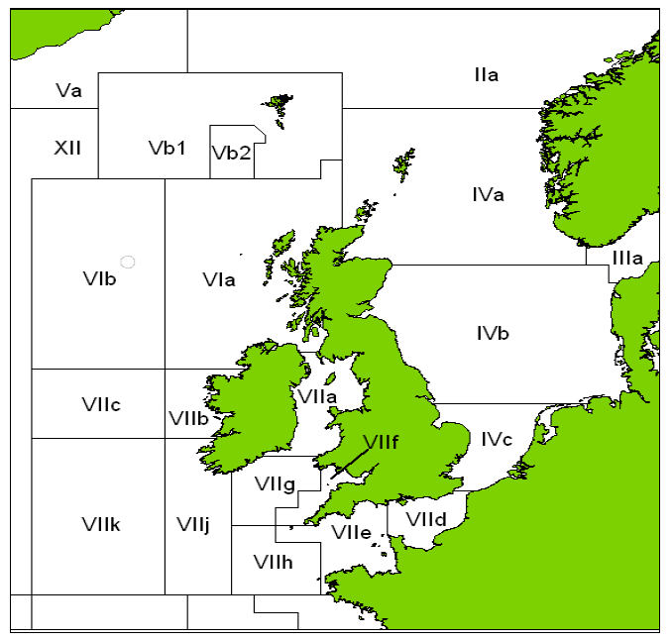
European cod: Iconic fish at risk
West of Scotland cod (Vla)
Fishing pressure
Stock size
Rockall cod (VIb)
Fishing pressure
ICES advice 2022: 0t
Stock size
Kattegat cod (21)
ICES advice 2022: 14t
Fishing pressure
Stock size
Irish Sea cod (Vlla)
Fishing pressure
ICES advice 2022: 0t
Stock size
North Sea cod (IV, Vd, 20)
ICES advice 2022: 74t
Fishing pressure
Stock size
Celtic Sea cod (Vll e-k)
ICES advice 2022: 14,276t
Fishing pressure
Stock size
ICES advice 2022: 0t
F > Fmsy, SSB < MSY Btrigger
F > Flim, SSB < Blim
Notes:
One of our most icon fish is in crisis. The scientific assessment of cod stocks across Europe shows that almost all of them are in a critical state, requiring a drastic cut in catches as soon as possible. What we show here is the current fishing pressure and the size of the current spawning stock biomass (how many fish are there that can reproduce, to grow the stock). One red cross means the status is bad and two mean the status is absolutely abysmal. The question mark means the available data is not sufficient for an assessment of the reference points.
You can see that the situation for all stocks is either unsure or really really bad. Cod in the Irish Sea is at the lowest level ever. The population in the Celtic Sea has been reduced by 88% since 1981. In the North Sea, too, cod overall has declined by 68% since the late 1960s and the population that lives off the west coast of Scotland has fallen by 94% since 1981. Out of the 6 cod stocks shown here 3 have a TAC advice of zero tonnes for 2022, while the remaining 3 have a very small TAC advice (NS TAC is also small looking at the huge area).
When we look at the Kattegat things are not getting better. The biomass of Kattegat cod reached a historical low level in 2020. The stock has a zero advice and all targeted fishing is closed. And the two populations of cod in the Baltic Sea are not fairing any better: Since October this year all targeted fishing for cod in the Baltic Sea is closed and only a small bycatch TAC was agreed.

Slide 4
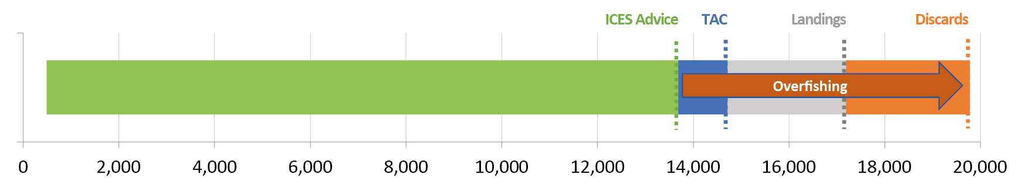
Overfishing of North Sea cod:
TACs on paper vs. Reality
Amount of Atlantic cod caught in the North Sea in 2020
34%
Weight in tonnes
North Sea: ICES subarea 4
Landings and discards are ICES estimates from the 2021 advice
45%
* ICES Advice 2021 – cod.27.47d20 – https://doi.org/10.17895/ices.advice.7746
Notes:
The mismanagement of cod gets completely new dimensions when we look at the actual catch details from 2020. This graph shows the actual catches of North Sea cod in area 4 in tonnes, taking from this year’s ICES advice.
For 2020 ICES recommended a maximum catch of 13,686 metric tons (green), but fisheries ministers set a higher catch quota (blue) and exceeded the advice by 8%.
As if that was not enough, due to cod bycatch in mixed fisheries, the real catch landed that year (grey) was significantly higher than the catch quota.
In addition, there was a large number of cod that were illegally discarded back into the sea (orange).
Taken together, the real catch of North Sea cod in 2020 was 34% above the official TAC and 45% above the scientific advice.

Slide 5
We ask fisheries ministers to:
End overfishing and set a all TACs at or below scientific advice.
Take into account the bycatch in mixed fisheries and set certain TACs below the maximum single species advice to protect the weakest stocks.
Consider that some species are also heavily impacted by the climate crisis and include an additional climate buffer when setting the TAC.
Make selective gear mandatory to reduce bycatch and increase control and monitoring measures to ensure compliance with the landing obligation.
Notes:
This can go, if we don‘t want to talk about our NGO recommendations here or if time is too tight!!!
Despite the 2020 deadline to end overfishing in the EU the state of fish stocks in the North Sea Atlantic is not good and progress is made too slow!
Moving forward, Europe needs a more joined up approach that considers the impacts of fishing on the whole marine ecosystem and recognises the need to limit the pervasive reach of fisheries if we are going to restore fish populations and ocean health.
For the ongoing negotiations on fishing opportunities in the North East Atlantic for 2022 we ask fisheries ministers to:
…
…

Slide 6
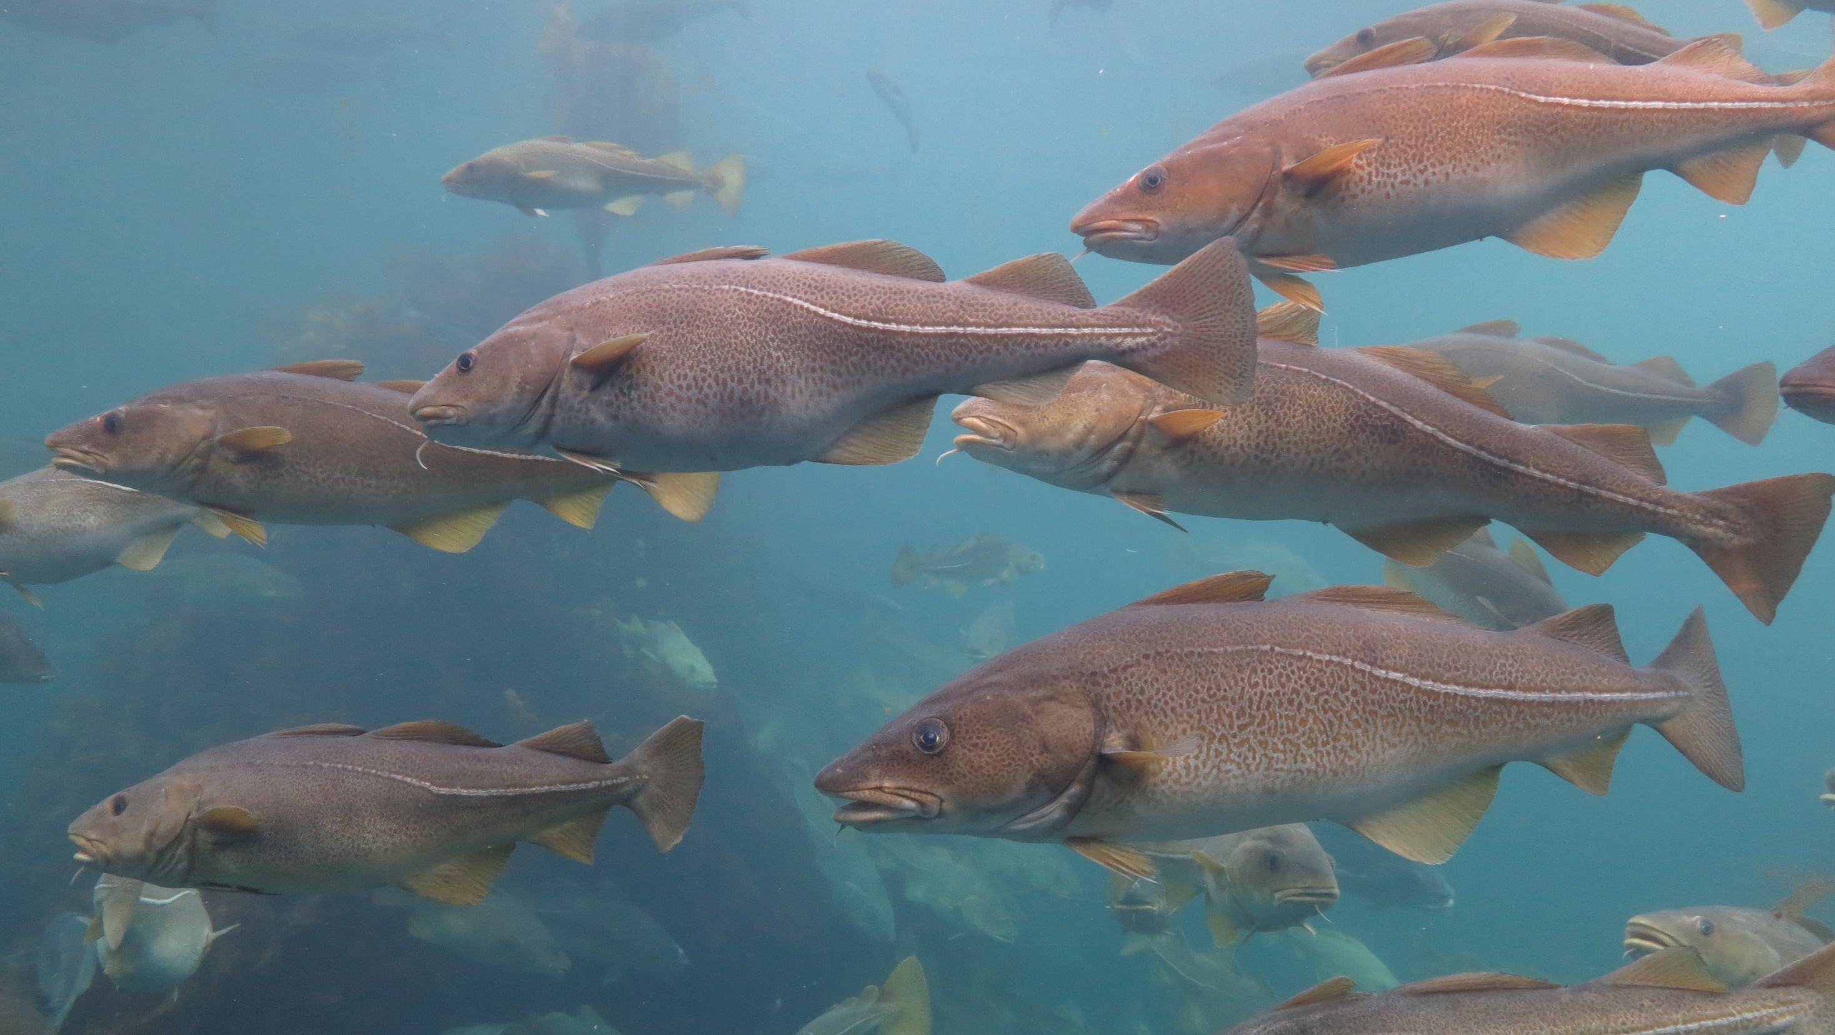
© GRID-Arendal / Peter Prokosch
Valeska Diemel
valeska.diemel@bund.net
Notes:
Thanks so much for your attention.

