Slide 1
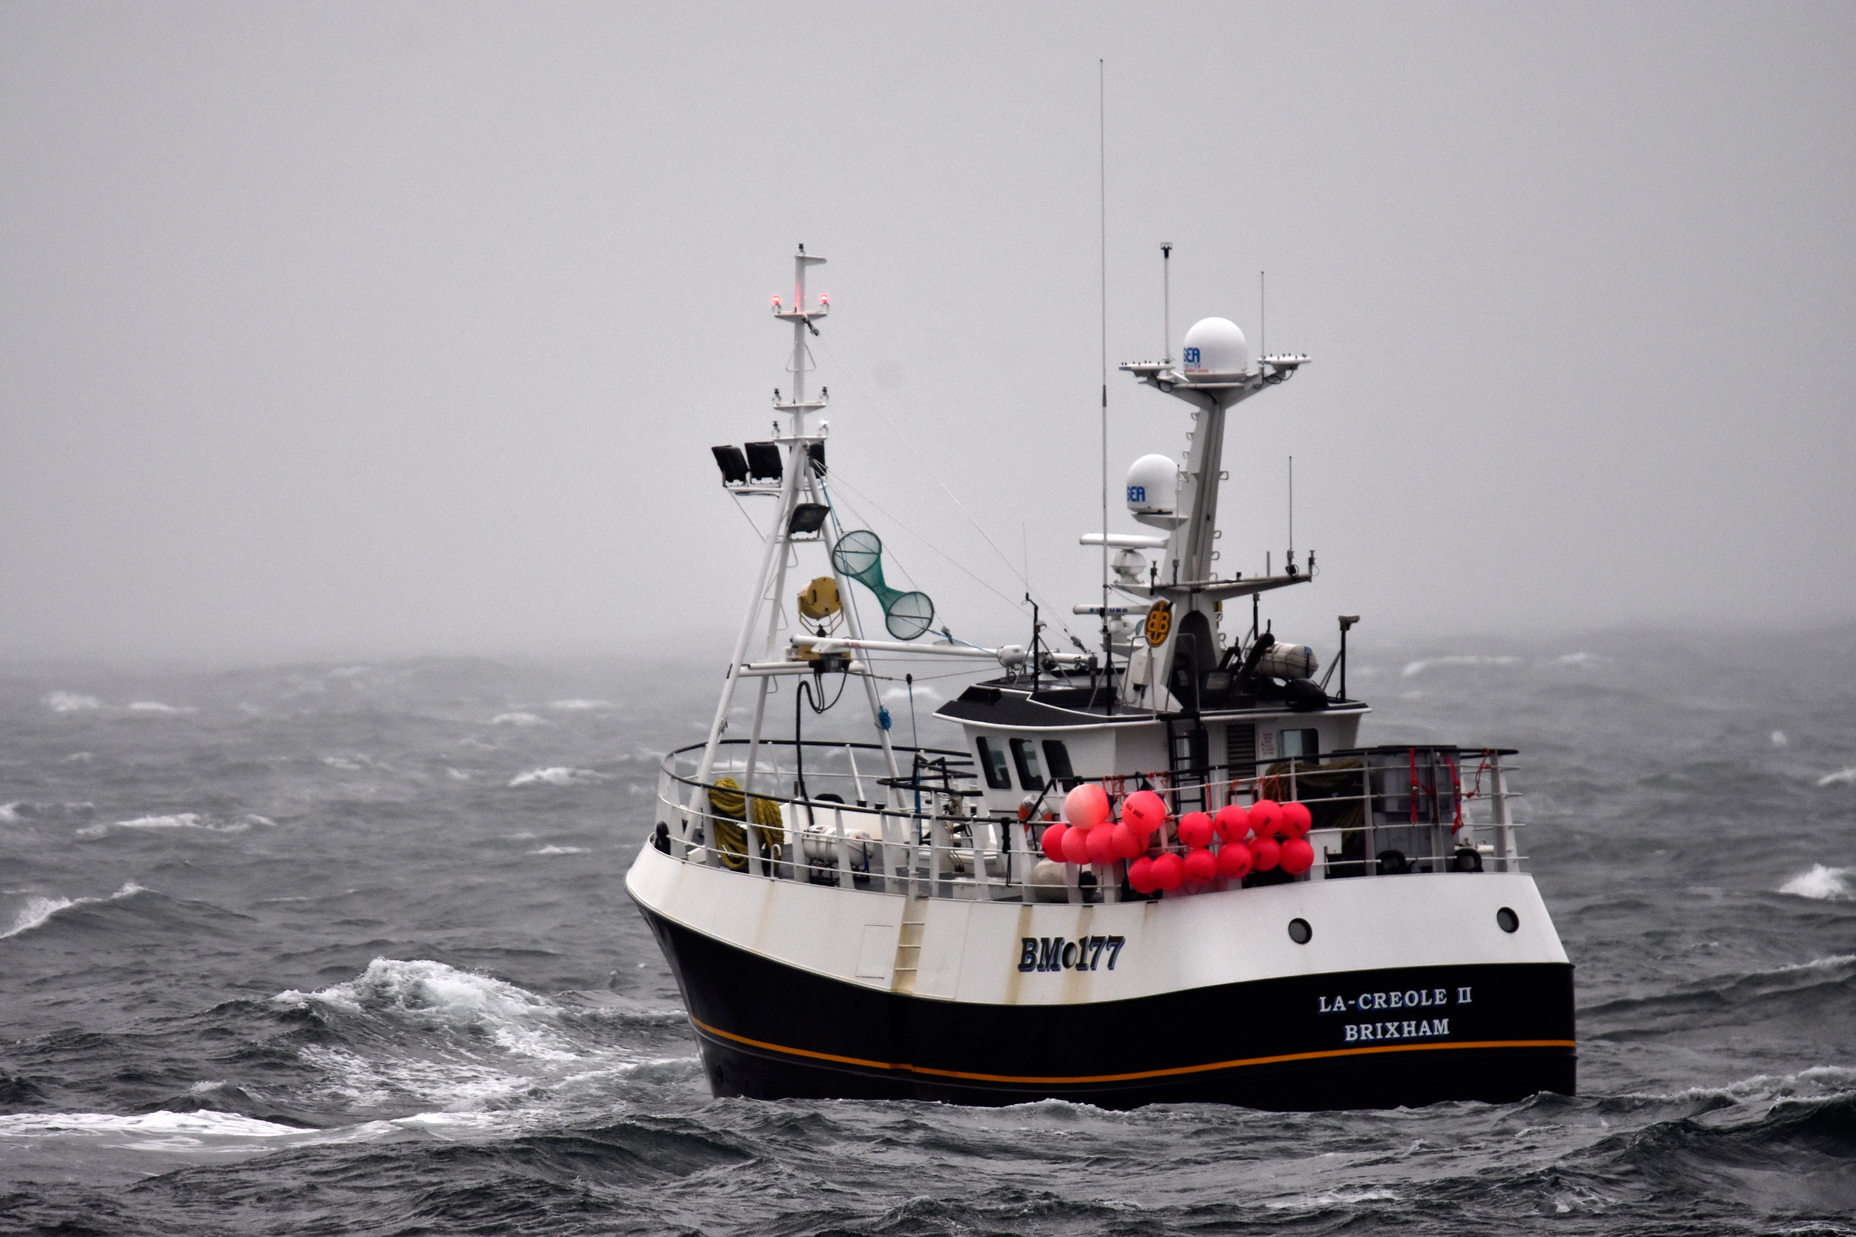
The future of fishing in Europe: Lessons learned from 1st year of post-Brexit TACs and a changing climate.
Javier López | Campaign Director
November 16th, 2021

Slide 2

Lessons learnt

Slide 3
Lessons learnt
Parties are willing to cooperate but there is pressure to identify themselves as winners.
Decisions on catch limits continue to be driven by non-environmental factors. Science continues to be ignored.
Transparency in the decision-making processes has not improved.
Fisheries is a totemic topic but (so far) fisheries and non-fisheries disputes are not affecting the catch limits decisions.
Climate change considerations are not attended when setting catch limits.

Slide 4
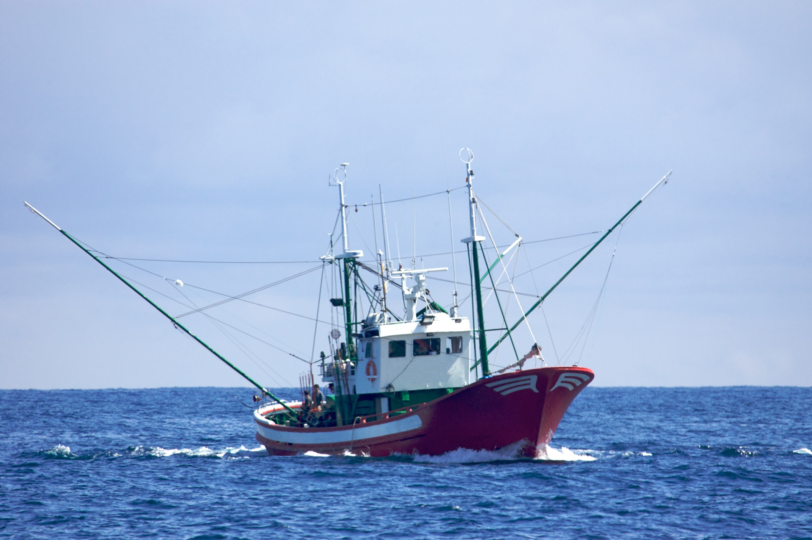
What to expect?

Slide 5
What to expect?
Negotiations for shared stocks are likely to last “only” few weeks and to conclude before December 10.
Decision on catch limits for EU exclusive fish stocks will be adopted during the 13/14 December AgriFish Council.
Agreements on 2022 catch limits are expected to be reached.
All parties committed to ignore the scientific advice when “necessary”.
Potential progress, but slow and insufficient to meet the ending overfishing objective.

