Slide 1
Setting fishing limits - how does it work?
Processes and the law, including the Brexit Agreement
Jenni Grossmann
Science and Policy Advisor
16 November 2021
Notes:
The various negotiations on fishing limits can get quite confusing, with several different processes involving different combinations of the various fishing nations/Parties, and various rules and principles enshrined both in international and domestic legislation; Brexit has added another layer of complexity; so this presentation is meant to give an overview of the key processes and which Parties and stocks are involved, as well as the important rules and objectives governing the setting of fishing limits in the Northeast Atlantic

Slide 2
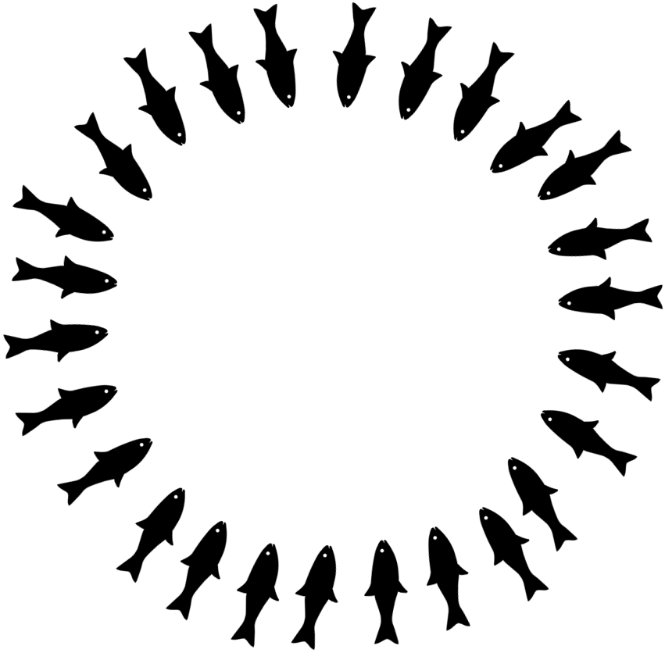
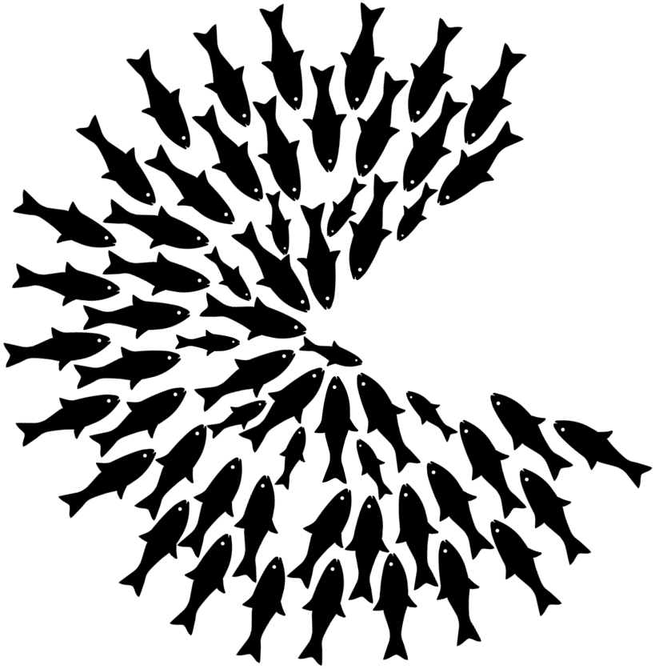
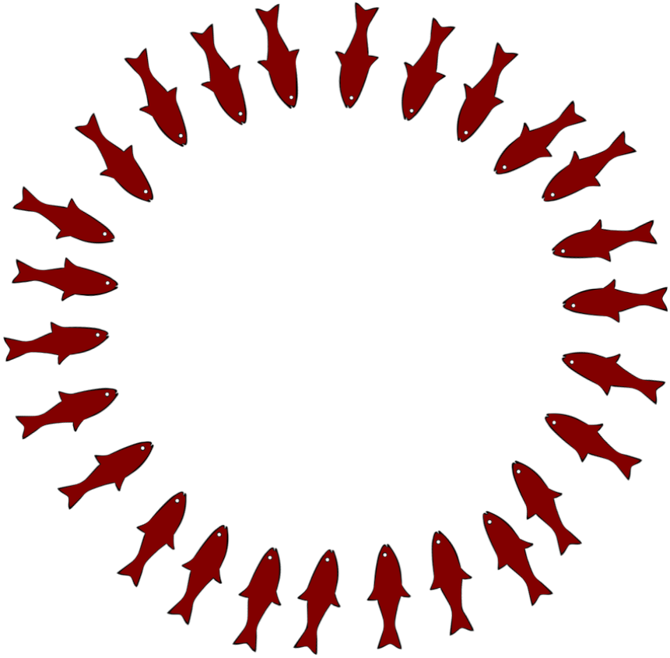
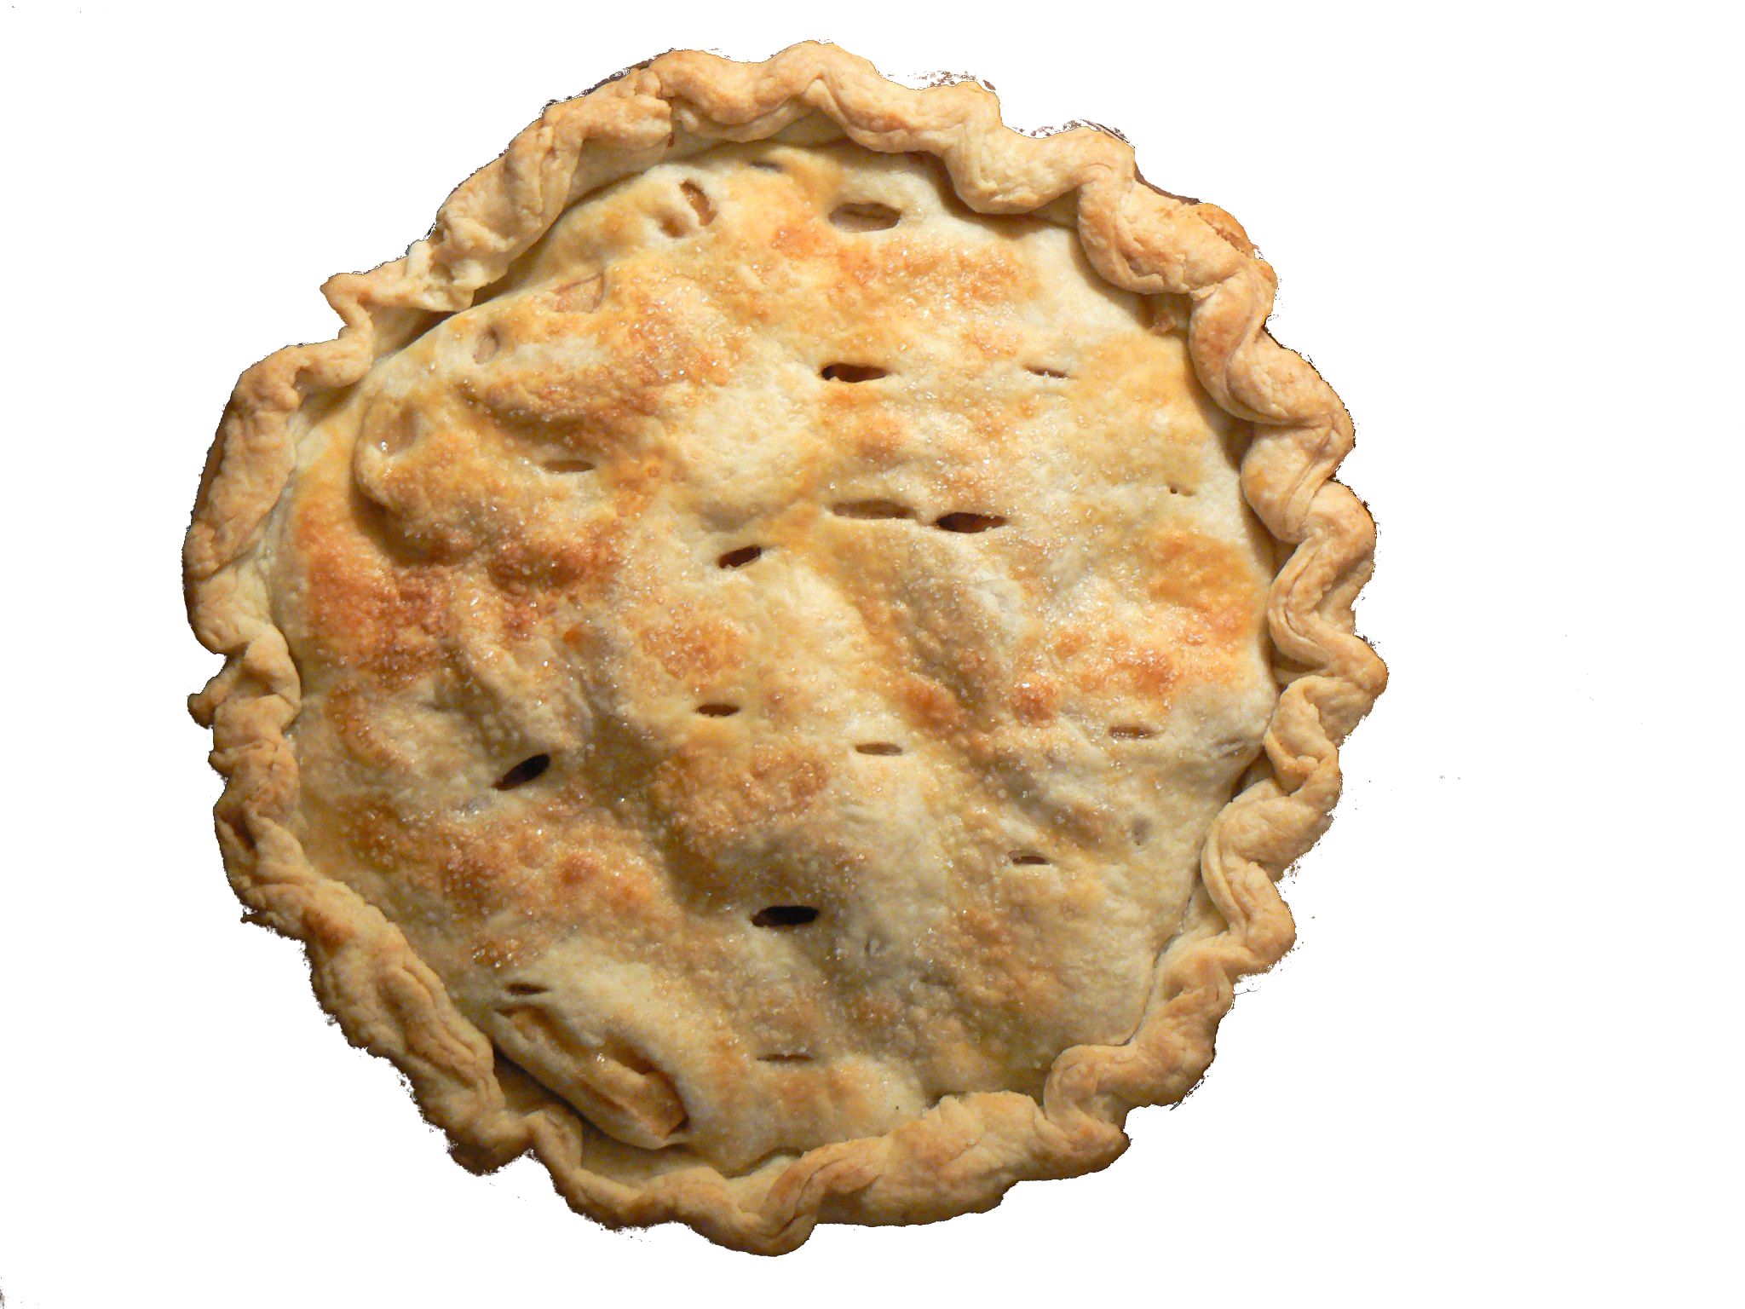
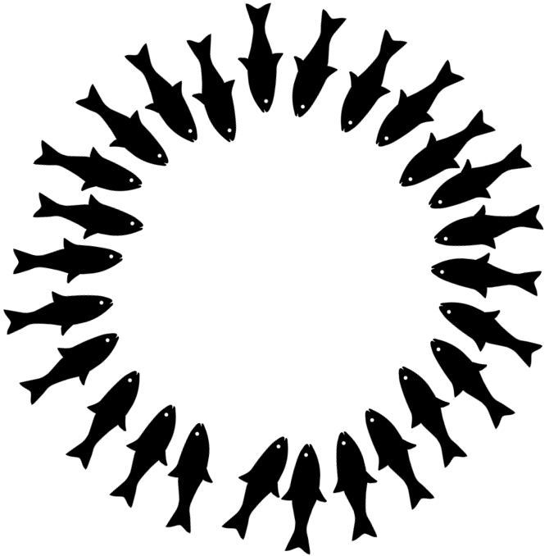
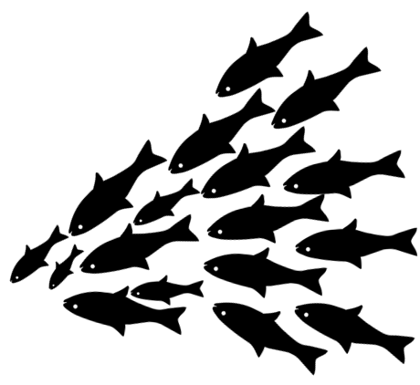
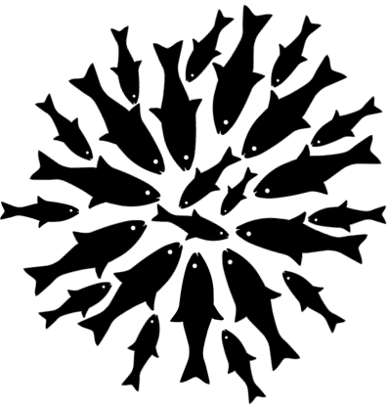
How big is the pie and how do we split it?
Pie photo: modified from https://www.flickr.com/photos/benimoto/2109973292
In other words…
How much fish is there in the sea?
How much can we catch sustainably?
How do we share the fish?
Data collection
Scientific advice
Negotiations
Fishing limits or Total Allowable Catches (TACs)
Notes:
So, how big is the pie and how do we split it? – or in other words: how much fish is there in he sea? How much of it can we catch sustainably, in line with science and the law? And how do we share the catch between the different countries/Parties/players?
First of all, data collection, feeding in to stock assessments done by scientists
They provide scientific advice on what maximum catch can be sustainably taken
This feeds into the negotiations – there are different processes for this depending on the stocks and players involved which I will get to in the next few slides, but overall such negotiations often remain a sort of black box, where discussions and decisions take place behind closed doors with limited opportunity for stakeholders or the public to follow more concretely who said what/pushed which way
At the end we have the fishing or catch limits, also called Total Allowable Catches or TACs; if us environmental NGOs had our way, then these could even be set below the scientific advice in some cases, for example to factor in a sort of buffer against other pressures like climate change, or to safeguard other stocks caught in the same fisheries which would otherwise be overfished; more often however, they just follow the advice, i.e. are set exactly at the advised maximum catch level; and sadly, despite the EU already having missed its legal deadline to end overfishing by 2020, in many cases they are still set above the advice
Once the TACs are set, there is of course still the question how to split this between the different Parties fishing the stock; how this is done again depends on the process; for example in the EU there is a so called “relative stability key” which means that each country always gets the same % share of a specific TAC, so the overall TAC amount changes between the years, but the share remains the same, so that at least such sharing discussions are not reopened every year; for the EU/UK shared stocks it is similar; however, there are also other international processes like the Coastal States negotiations between the EU, the UK and several other countries, where there is no agreed sharing arrangement in place because there are disputes about who should get what share

Slide 3
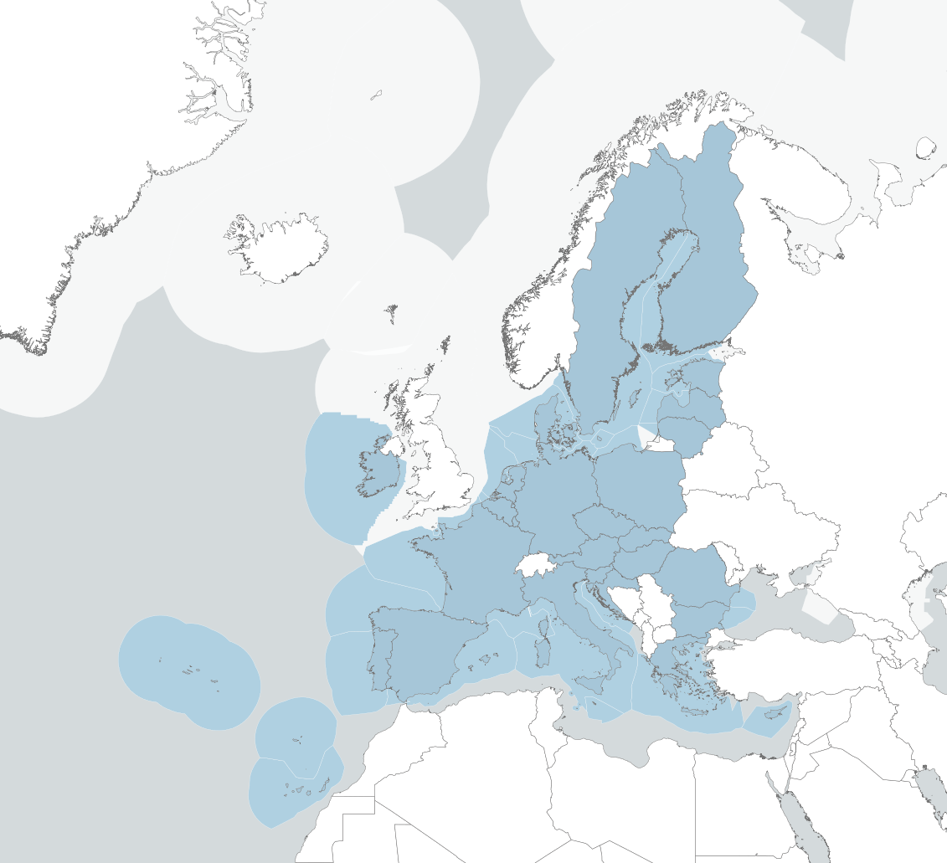
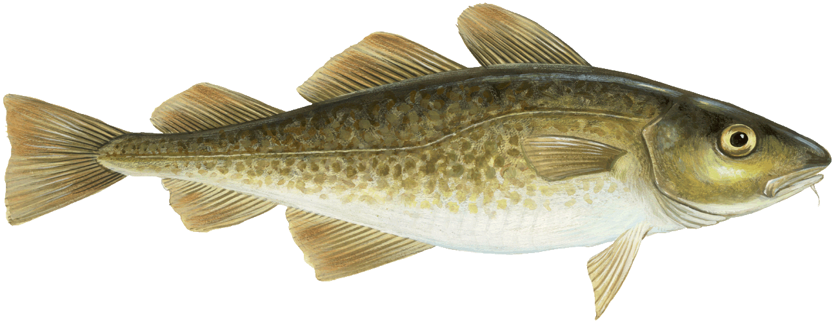
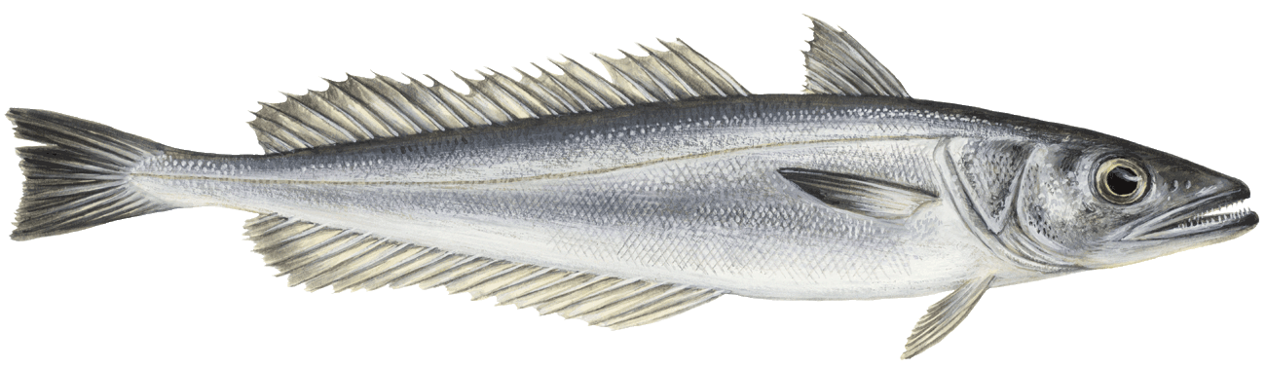
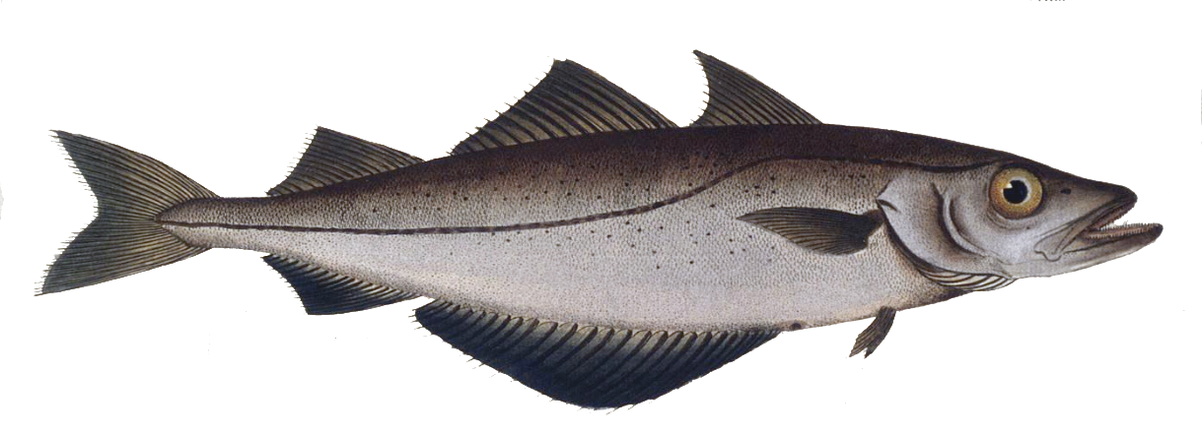
EU only stocks
Two main fora:
  October Council: Baltic; 10 stocks
  December Council: now mostly Bay of Biscay, Atlantic Iberian waters, Kattegat; ~ 30 stocks; big impact of Brexit on the stocks covered
Process:
  Commission proposal
  Council of EU fisheries ministers
  Agreed TACs
Examples:
  Eastern and Western Baltic cod
  Pollack
  Southern hake
European Union
Notes:
Two key processes re: TAC-setting: October Council for Baltic stocks; December Council for other EU only stocks; this used to over the majority of fish stocks exploited by the EU, but the scope has been decreased a lot due to Brexit, since most stocks are now shared between the EU and the UK; there is also a third process for the Deep Sea stocks but that only happens every 2 years and is not taking place this year
Process for both October and December Council: COM makes a proposal with numbers for all the stocks, reflecting scientific advice and other considerations; this is then discussed in the weeks leading up to the Council meeting between the COM and Member State representatives; at the Council meeting the EU fisheries ministers from all the EU countries discuss usually over 1-2 days and agree all the TACs; each Member State has the same % share of a specific TAC each year and then allocates its share to its fishers
Examples: Eastern and Western Baltic cod, both in bad shape, were covered by this year’s October Council; Southern hake: important stock for Spain, Portugal and France; Pollack: data-limited and has a history of TACs being set above the available precautionary scientific advice that is based on fishing less hard when information is more limited
Note: this map displays all the EU waters, but not all of these fall under one of these processes; for example, largely no TACs in the Mediterranean, although the December Council does cover some Med issues as well; many stocks in waters adjacent to EU waters now fall under EU/UK negotiations

Slide 4
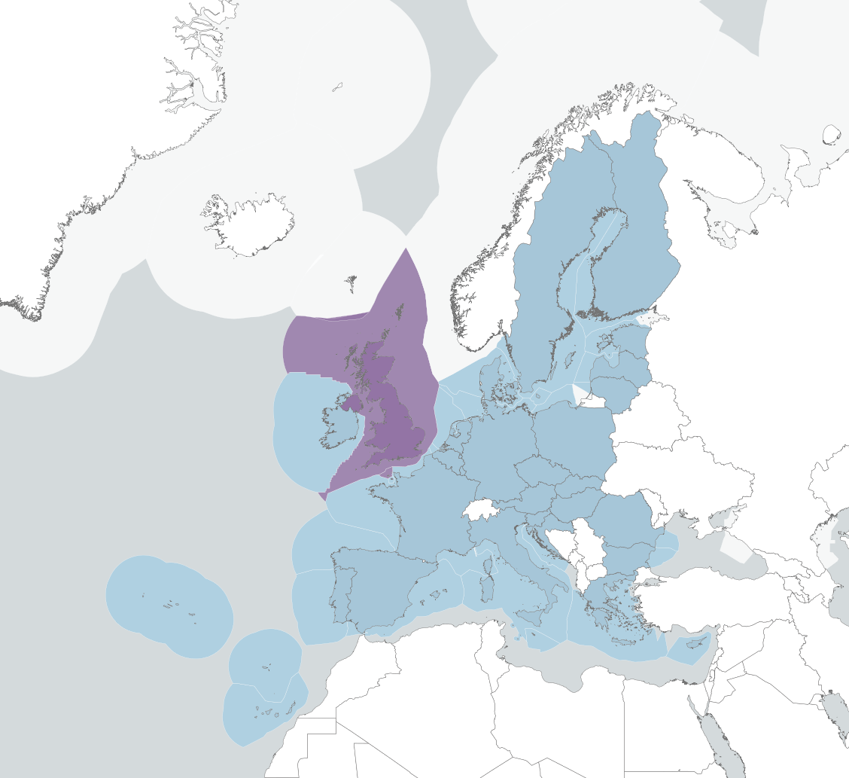

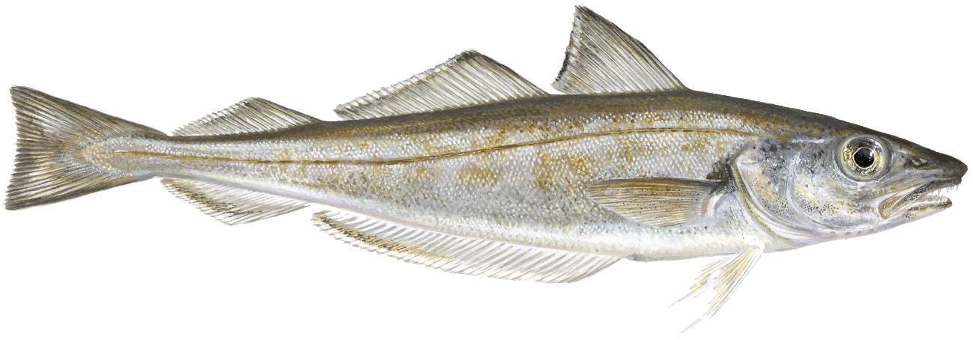
EU/UK shared stocks
Majority of stocks that used to fall under December Council now shared with the UK; over 70 stocks
Trade and Cooperation Agreement between the EU and the UK
New process:
  Commission represents the EU, based on a Council mandate
  Series of negotiation rounds
  Agreed written record
Examples:
  Celtic Sea and West of Scotland cod
  Irish Sea whiting
  Sandeel
United Kingdom
European Union
Fish images from: Fundació ENT & Ecologistas en Acción (2016): Comparison of EU Commission’s 2015 and 2016 communications on “EU fisheries in the Atlantic, North Sea and Baltic Sea in line with maximum sustainable yield (MSY)”.
Notes:
Bulk of the stocks that used to be covered by December Council are now EU/UK shared stocks falling under this new process
TCA: lays down the new relationship between the EU and the UK as an independent coastal State; covers a wide range of areas, including fisheries; it basically sets out the % shares for both Parties and various rules and objectives for the management of shared stocks and cooperation
New process (maybe save for the law slide):
international negotiation between EU and UK as an independent coastal state;
this year was the first time the shared TACs were set under this process, and because the TCA was not yet in place until the start of the year and there were a lot of issues to discuss and resolve, the negotiations for the 2021 TACs dragged on until June this year;
going forward there is a deadline to agree on shared TACs by 10th Dec, or 20th at the very latest in order to have TACs in place for the next year, so the main negotiation month is November (i.e. right now)
COM negotiates on behalf of the EU, based on a mandate from the Council
Several negotiation rounds; mix of Plenary meetings which some stakeholders have access to as part of the UK or EU MS delegations, and other less open meetings, for example between the Heads of Delegation and their teams; results of the consultations are then put in an agreed written record that is then transposed into domestic law on both sides
Examples:
Celtic Sea and West of Scotland cod: both vulnerable stocks in historically bad shape, mostly caught as bycatch in other/mixed fisheries fisheries
Irish Sea whiting: similar, mostly a bycatch in the Norway lobster fishery; NGO concerns about the lack of progress to recover these stocks
Sandeel: interesting example since this turned into quite a bit discussion point in the negotiations for 2021, and most likely again for next year; UK took an environmentally progressive position, since this is an important forage fish species, that seabirds and other wildlife feed on, so the UK wanted the TAC to be set below the advice or industrial fisheries even to be closed; more on this in Javier’s presentation (maybe?)

Slide 5
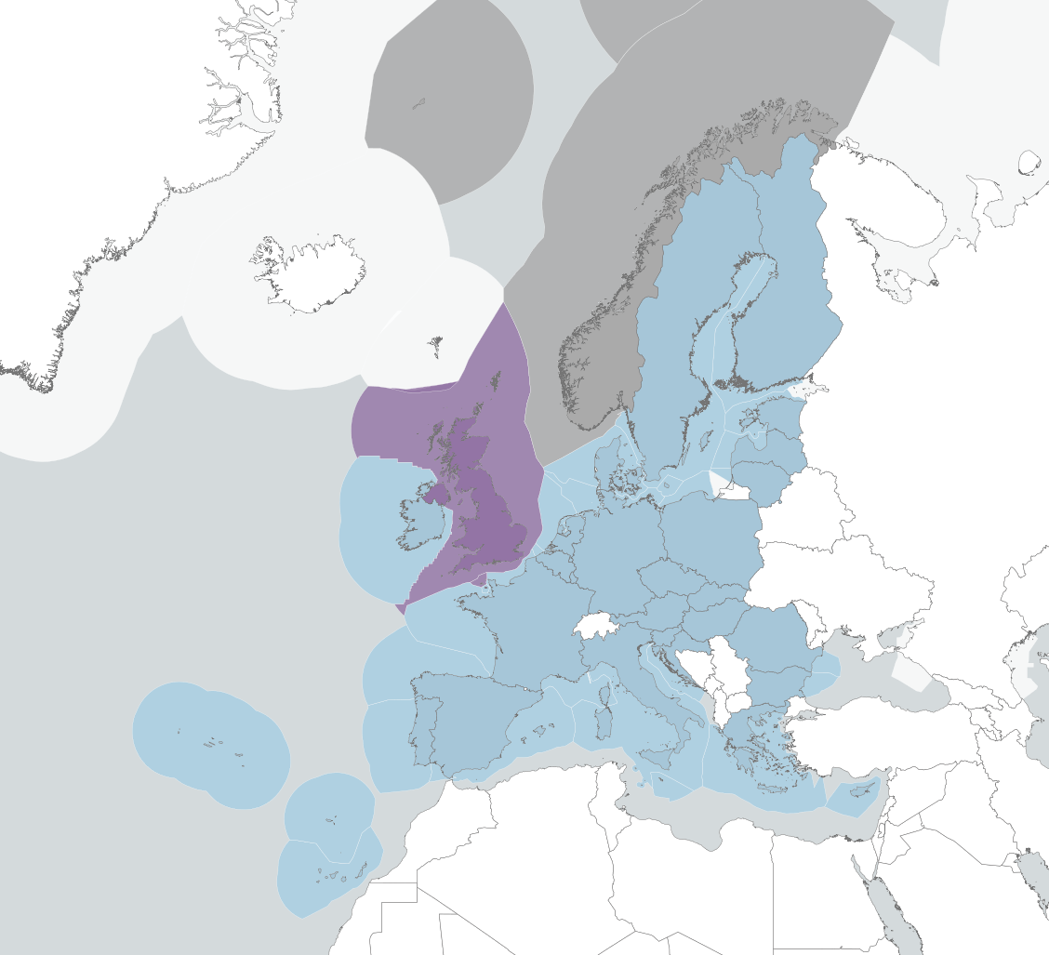
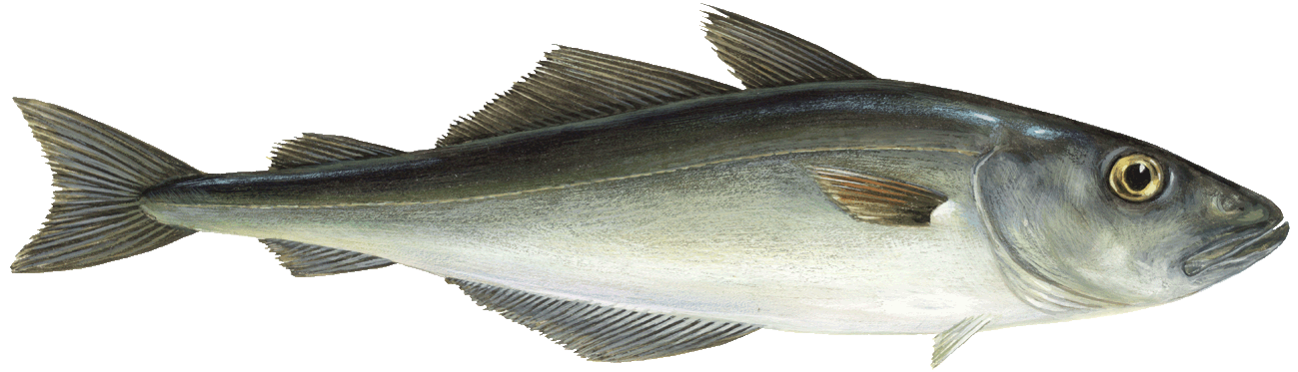
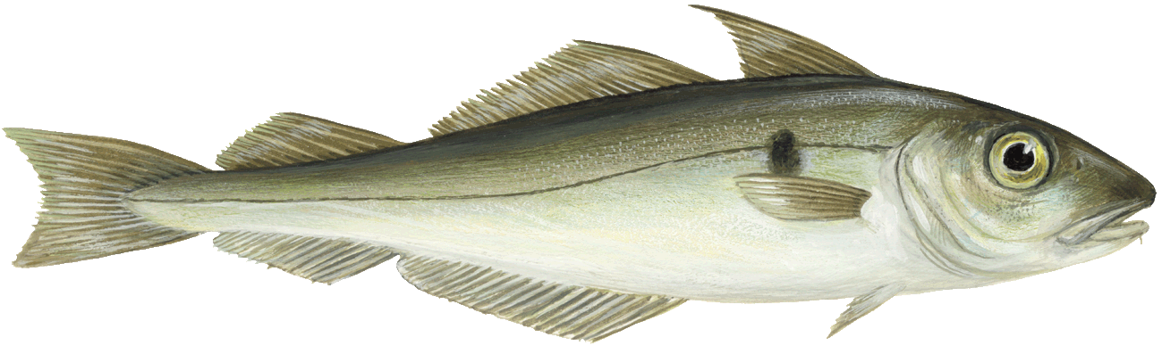
EU/UK/Norway shared stocks
Similar process as EU/UK, involving Norway, including trilateral and bilaterals
Covers 8 stocks and some not (yet) jointly managed stocks
Examples:
  North Sea cod
  North Sea haddock
  North Sea saithe
Norway
United Kingdom
European Union
Fish images from: Fundació ENT & Ecologistas en Acción (2016): Comparison of EU Commission’s 2015 and 2016 communications on “EU fisheries in the Atlantic, North Sea and Baltic Sea in line with maximum sustainable yield (MSY)”.
Notes:
Similar process to EU/UK; used to be EU/Norway, now it’s EU/UK/Norway, i.e. a trilateral but also with some bilateral elements between UK/Norway and EU/Norway
Examples:
NS cod: in historically bad shape, has always been overfished; more on this in the second presentation
NS haddock: doing much better, unfortunately they are both caught in the same fishery, so if you follow the advised increase for haddock that will further put at risk cod recovery
NS saithe: also in bad shape

Slide 6
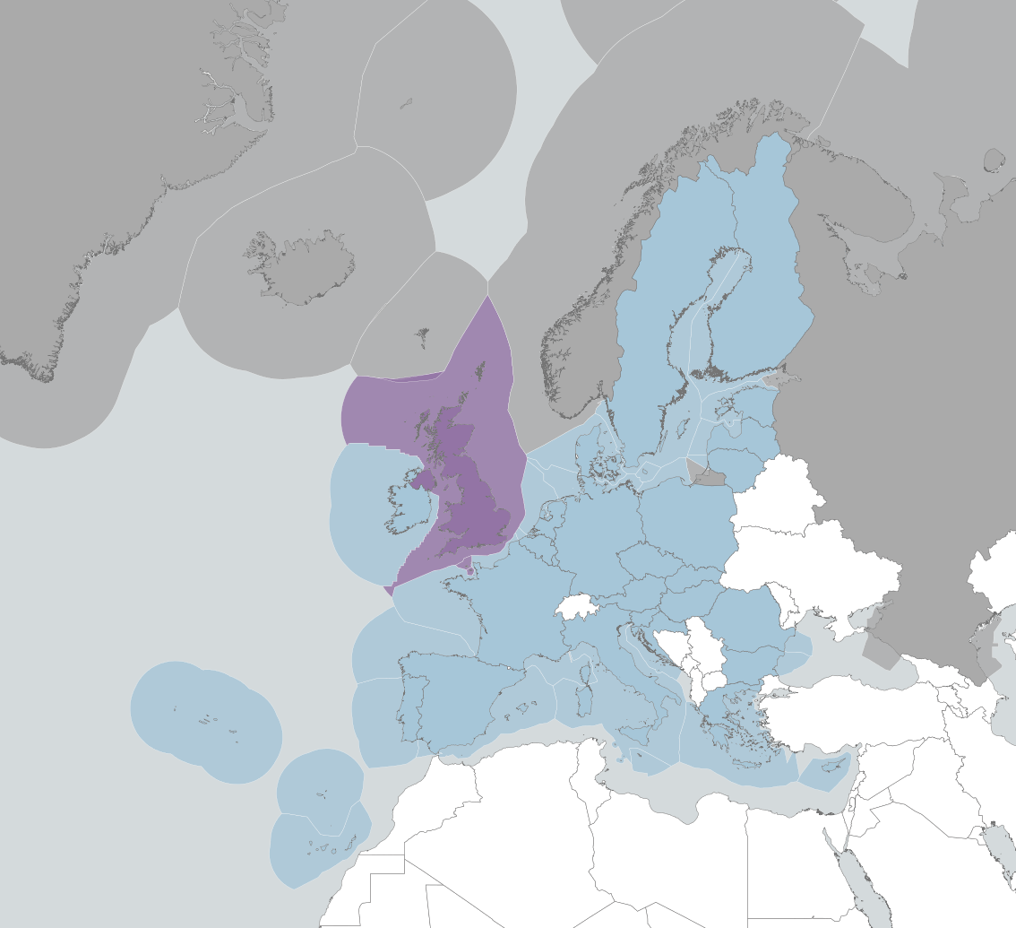
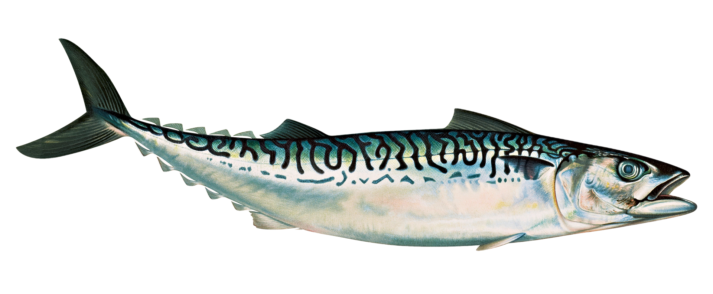
Coastal States
Greenland
Some widely distributed stocks of interest to several third countries
Coastal State negotiations:
  Key issue: no sharing arrangement for some stocks, leading to overfishing
Example:
  Mackerel
Iceland
Faroe Islands
Norway
Russia
United Kingdom
European Union
Mackerel image from: https://pixabay.com/illustrations/mackerel-fish-animal-food-seafood-6192529/
Notes:
Some widely distributed stocks are negotiated by the coastal states in the NE Atlantic, including Iceland, Faroe Islands, Greenland and to some extent Russia
Key issue: no sharing arrangement for some stocks → agreement on how big the pie should be but then everyone sets unilateral fishing limits, i.e. claims what they think their piece should be, and the overall amount is often bigger than the actual pie
NEAFC

Slide 7
What happens in the black box?
Many fishing limits still exceed scientific advice – how can this happen?
Key issue: lack of transparency and accountability
Some improvements, but long way to go
Data collection
Scientific advice
?
?
?
Negotiations
?
?
?
Fishing limits or Total Allowable Catches (TACs)
Notes:
One thing that all these various processes have in common is that they all involve negotiations, be it between EU fisheries ministers amongst themselves and the COM, or between different coastal states
Going back to the principle process, we might wonder: what actually happens in this negotiation blackbox? This is important/interesting especially because in many cases the TACs are still set above the best available scientific advice
Key issue that all these processes share to varying extents; lack of transparency and accountability, both re: access to the negotiations and documentations of the discussions, making it difficult for stakeholders like ourselves or the general public or journalists like yourselves to follow how these decisions were reached and who pushed for what, who were the “good” and the “bad” guys, so this blackbox makes it easier for the various players to make “fishy decisions” without proper public scrutiny

Slide 8
What’s in the law?
Domestic and international legislation
Key rules and principles:
  Follow the science: set fishing limits at or below the advice
  End overfishing: Maximum Sustainable Yield (MSY) as the limit
  Be more cautious when information is limited: the precautionary approach
  Consider ecosystem needs and impacts: factor in bycatch, food supply, climate change impacts…
Key legal deadlines:
  The EU’s MSY deadline: 2020 – already missed, but still applies going forward
  Deadline for EU/UK shared TACs: 10th / 20th December; default: follow the science
Notes:
Another thing that all these processes have in common that there are some important rules and principles the Parties involved have to follow in order to set sustainable fishing limits in line with science and the law
For example there is the Common Fisheries Policy in the EU, the UK Fisheries Act in the UK, the Trade and Cooperation Agreement / Brexit Agreement between the EU and the UK, and some international legislation like the United Nations Fish Stocks Agreement and United Nations Convention on the Law of the Sea
Don’t want to go into a lot of technical detail here, but happy to follow up if there are specific question; key legislation: CFP, TCA, international law
Key principles and rules are enshrined in law and most of the Parties have repeatedly reiterated their commitment to sustainable fisheries in public in various contexts; main principles/rules/objectives: follow science; end overfishing; be precautionary; factor in the ecosystem and impacts on it
Key legal deadlines: EU’s MSY deadline (missed but still applies, i.e. unsustainable TACs are now illegal); TCA deadline to reach agreement and otherwise default to scientific advice

Slide 9
What happens next?
10 Dec: 1st deadline to reach EU/UK agreement
20 Dec: 2nd deadline to reach EU/UK agreement
EU/UK Round 1
EU/UK Round 2
EU/UK Round 3
8-14 Nov
15-21 Nov
22-28 Nov
29 Nov- 5 Dec
6-12 Dec
13-19 Dec
20-26 Dec
27 Dec- 3 Jan
2022…
? ? ?
EU/UK/ Norway Round 2
13/14 Dec: December Council
Future: Specalised Committee on Fisheries…
Notes:
Overview of the various overlapping negotiations and what was/will be agreed when, starting with last week and until the end of the year
EU/UK started with a slight delay last week; this week we got round 2 of both EU/UK and EU/UK/Norway, next week round 3; updated as we go along
Key deadline: 10th Dec – EU/UK agreement needs to have been reached, 20th Dec as final deadline if 10th is not met; after that the default is to set unilateral provisional TACs in line with the science
Dec Council 13/14th Dec: EU only stocks
Going forward: various topics to discuss between EU and UK as part of the SCF

Slide 10
Sustainability on paper vs. on the water
Setting fishing limits in line with science and the law is just step 1
Outstanding issues to ensure fishing limits are actually sustainable:
  Illegal discarding → ensure proper control and monitoring
  Vulnerable bycatch stocks in mixed fisheries → prioritise their recovery
  Lack of sharing arrangement for some stocks → agree how to split the pie
  Other topics: sustainable long-term management strategies, non-quota stocks, Specialised Committee on Fisheries, negotiation black box…
Treat what you hear about “sustainable fishing limits” with caution – we need sustainability on the water, not just on paper!
Notes:
TACs in line with science and the law are important, but not enough to ensure sustainability; other aspects that need attention:
Need proper monitoring and control; clamp down on illegal discarding
Bycatch stocks / mixed fisheries; restore bycatch stocks
Coastal States: lack of sharing arrangement → more pieces than pie
Other issues: lack of long-term management strategies; management of non-quota stocks; SCF; lack of transparency (open up the black box)
Key take home message: you are likely to hear/see a lot of statements about “sustainable fishing limits” – important to treat these with caution since we need sustainability on the water, not just on paper

Slide 11

Thank you
Jenni Grossmann
Science and Policy Advisor
t +44 (0)303 050 5943
JGrossmann@clientearth.org

