Slide 1
Fisheries bycatch of sensitive species and harmful fisheries subsidies - Biodiversity Strategy 2030
Andrea Ripol
Fisheries Policy Officer
www.seas-at-risk.org
14 January 2021 - Back to the Source Biodiversity Report Press Briefing

Slide 2
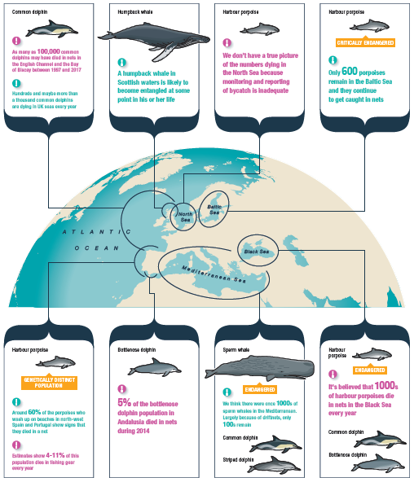
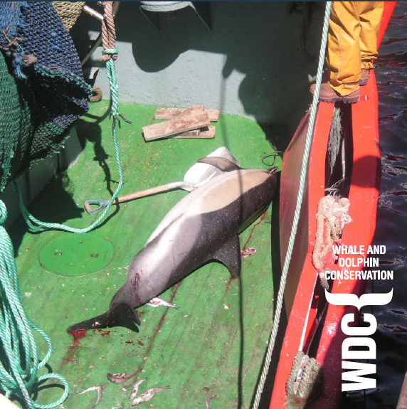
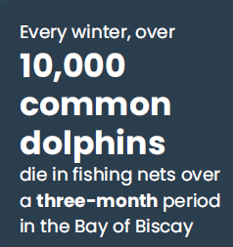
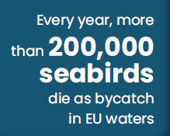
Bycatch of sensitive species in the EU

Slide 3
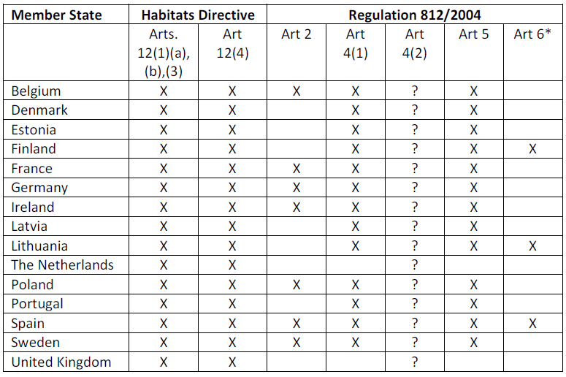
Bycatch and the EU Biodiversity Strategy 2030
ACTION proposed by NGOs:
Ensure that the Fisheries Action Plan protects sensitives species by including:
● Robust long-term monitoring of sensitive species;
● Adequate data collection of fisheries interactions;
● Application of measures to prevent and mitigate bycatch of sensitive species.
Member States fail to fulfil their obligations

Slide 4


Fisheries subsidies: 2030 is too late
ACTION proposed by NGOs:
Ensure that:
• The new European and Maritime Fisheries Fund as well as the upcoming revised State Aid
Guidelines require the elimination or redirection of subsidies harmful to biodiversity;
• The fuel tax exemption granted to the fishing sector is
removed during the revision of the Energy Taxation Directive.
By 2020

