Slide 1
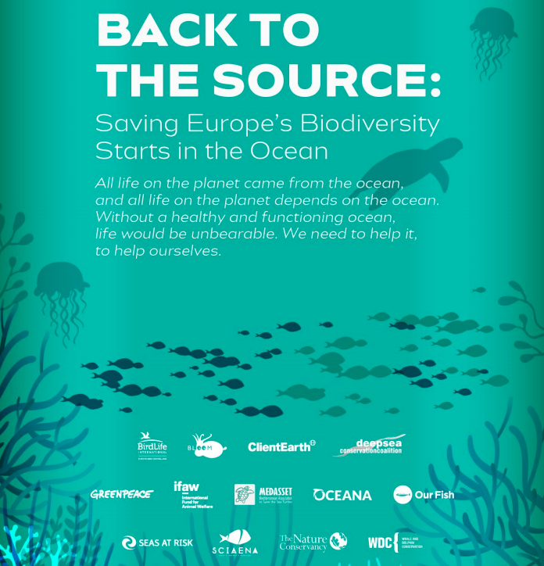
Saving Europe’s Biodiversity and Maximising Climate and Ecosystem Benefits of Fisheries
Rebecca Hubbard
Program Director
Our Fish

Slide 2

Enact an EU action plan to protect marine ecosystems and fisheries resources that meets current challenges
Precautionary buffers for climate change when setting fishing limits
Environmental Impact Assessments of fishing
  Food web impacts
  Impacts on non-target species
  Physical disturbance
  Capacity to mitigate and adapt to climate change (carbon rich habitats, coastal protection, etc)

Slide 3
Enact an EU action plan to protect marine ecosystems and fisheries resources that meets current challenges
Increased measures to minimise bycatch
Clear and transparent set of environmental and social criteria for allocating fishing quota
A drastic improvement in control

