Slide 1
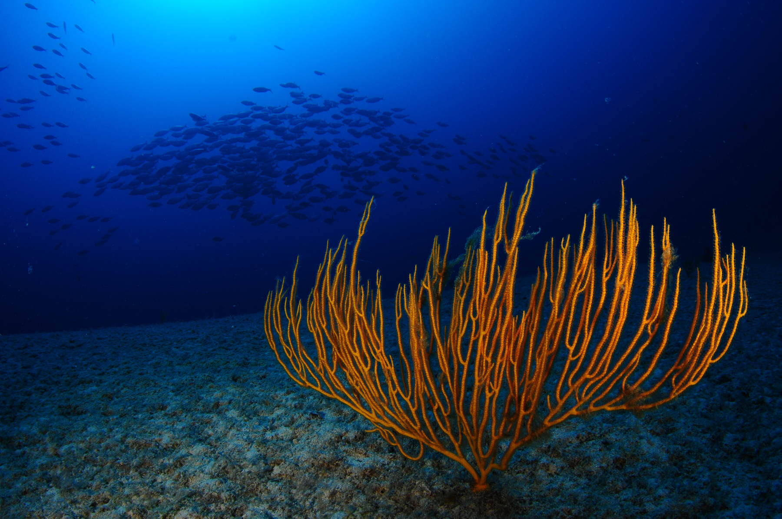

Protecting marine habitats,
Tackling bottom-trawling in Europe
Nicolas Fournier
Campaign Director, Marine Protection, Oceana Europe
14 January 2021 - Back to the Source, Biodiversity Report Press Briefing

Slide 2
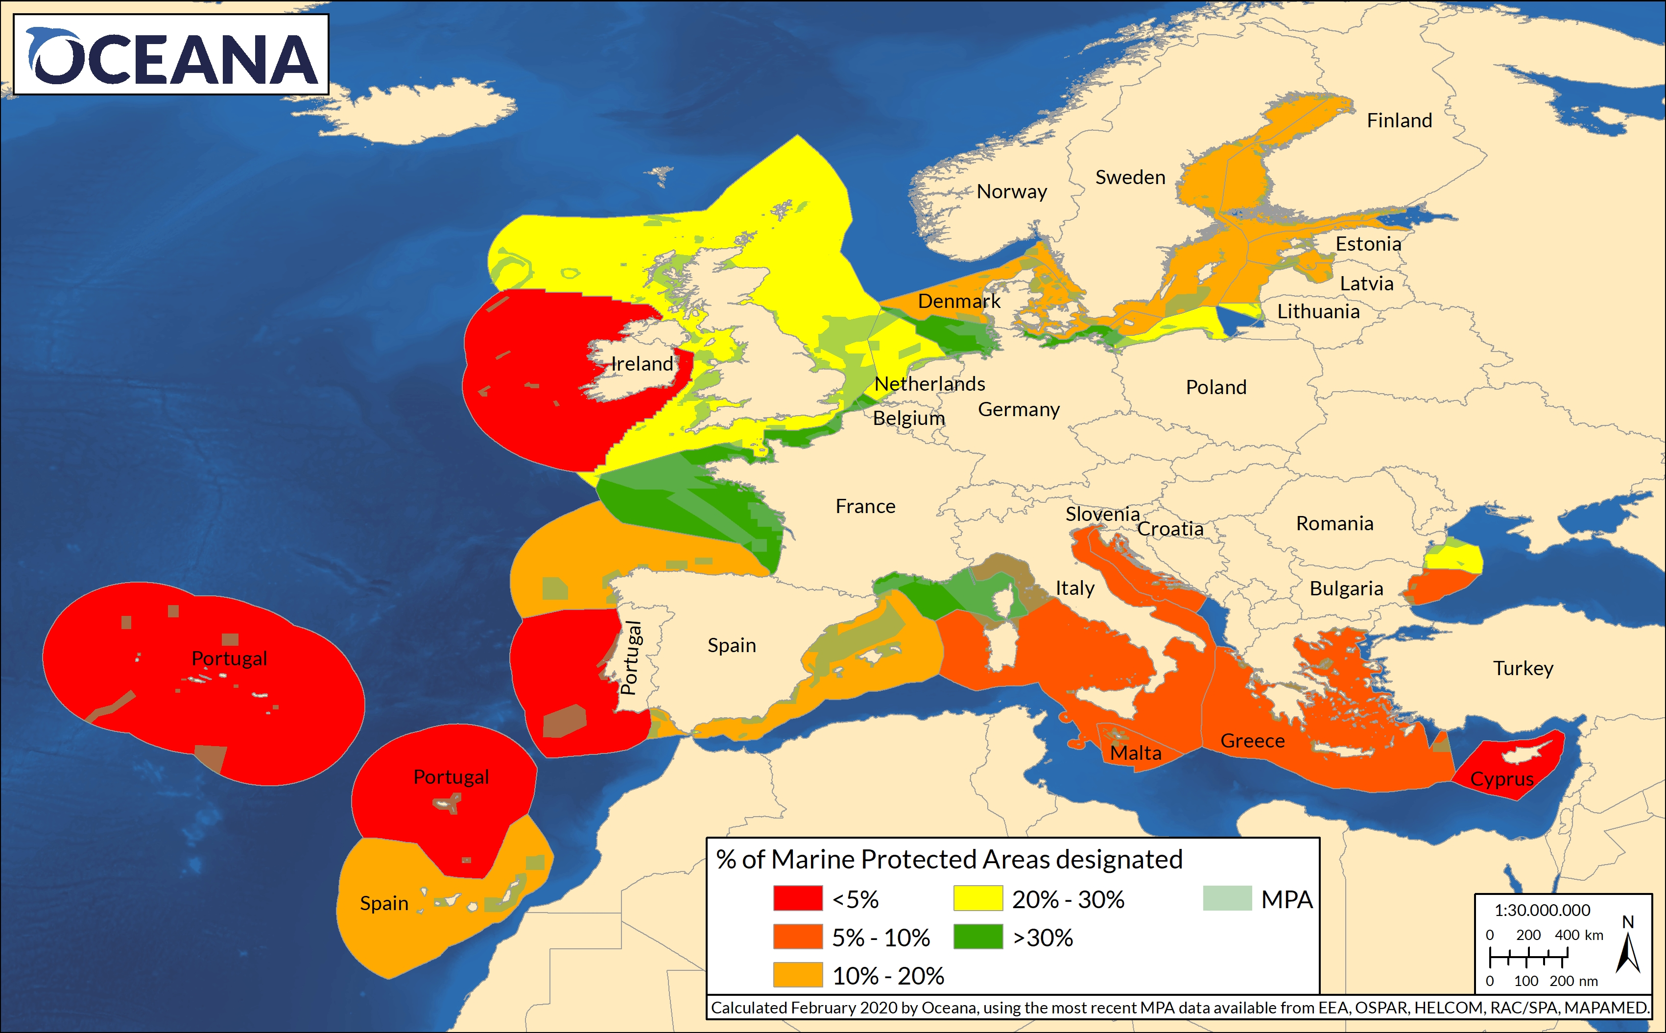
Protect 30% of all marine areas in EU and globally
> NGOs urge EP to reinforce the EU 2030 Biodiversity Strategy to
Raising ambition of 30% of EU seas “fully or highly” protected
Champion this ambition at UN level (30x30)
Also covering the “high-seas”, through negotiation of a new Global Ocean Treaty

Slide 3
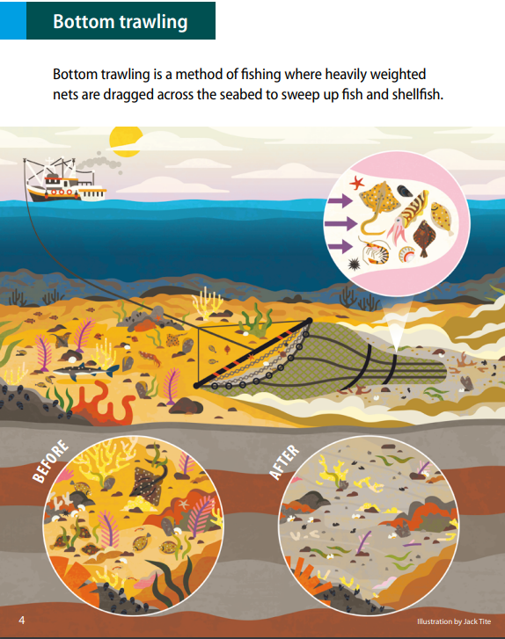
Bottom-trawling threatens marine habitats
Most EU MPAs are “paper parks”, 60% experience bottom trawling inside them
> NGOs call for a strict ban on the most destructive fishing practices in all EU MPAs
The coastal zone is the most productive part of our ocean
79% of EU coastal seabed is disturbed by bottom-trawling (EEA 2020)
> NGOs call trawling restrictions in near-shore waters to protect sensitive habitats.

