Slide 1
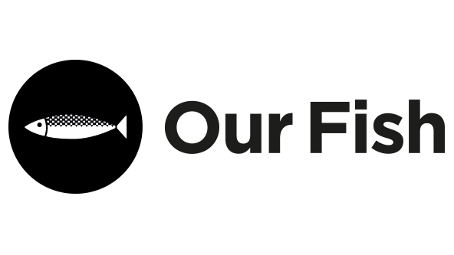
Fishing For Solutions to the Climate Crisis?
Rebecca Hubbard
Program Director
Our Fish

Slide 2
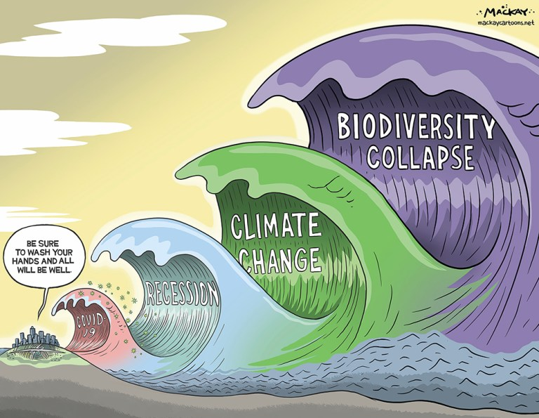

Slide 3
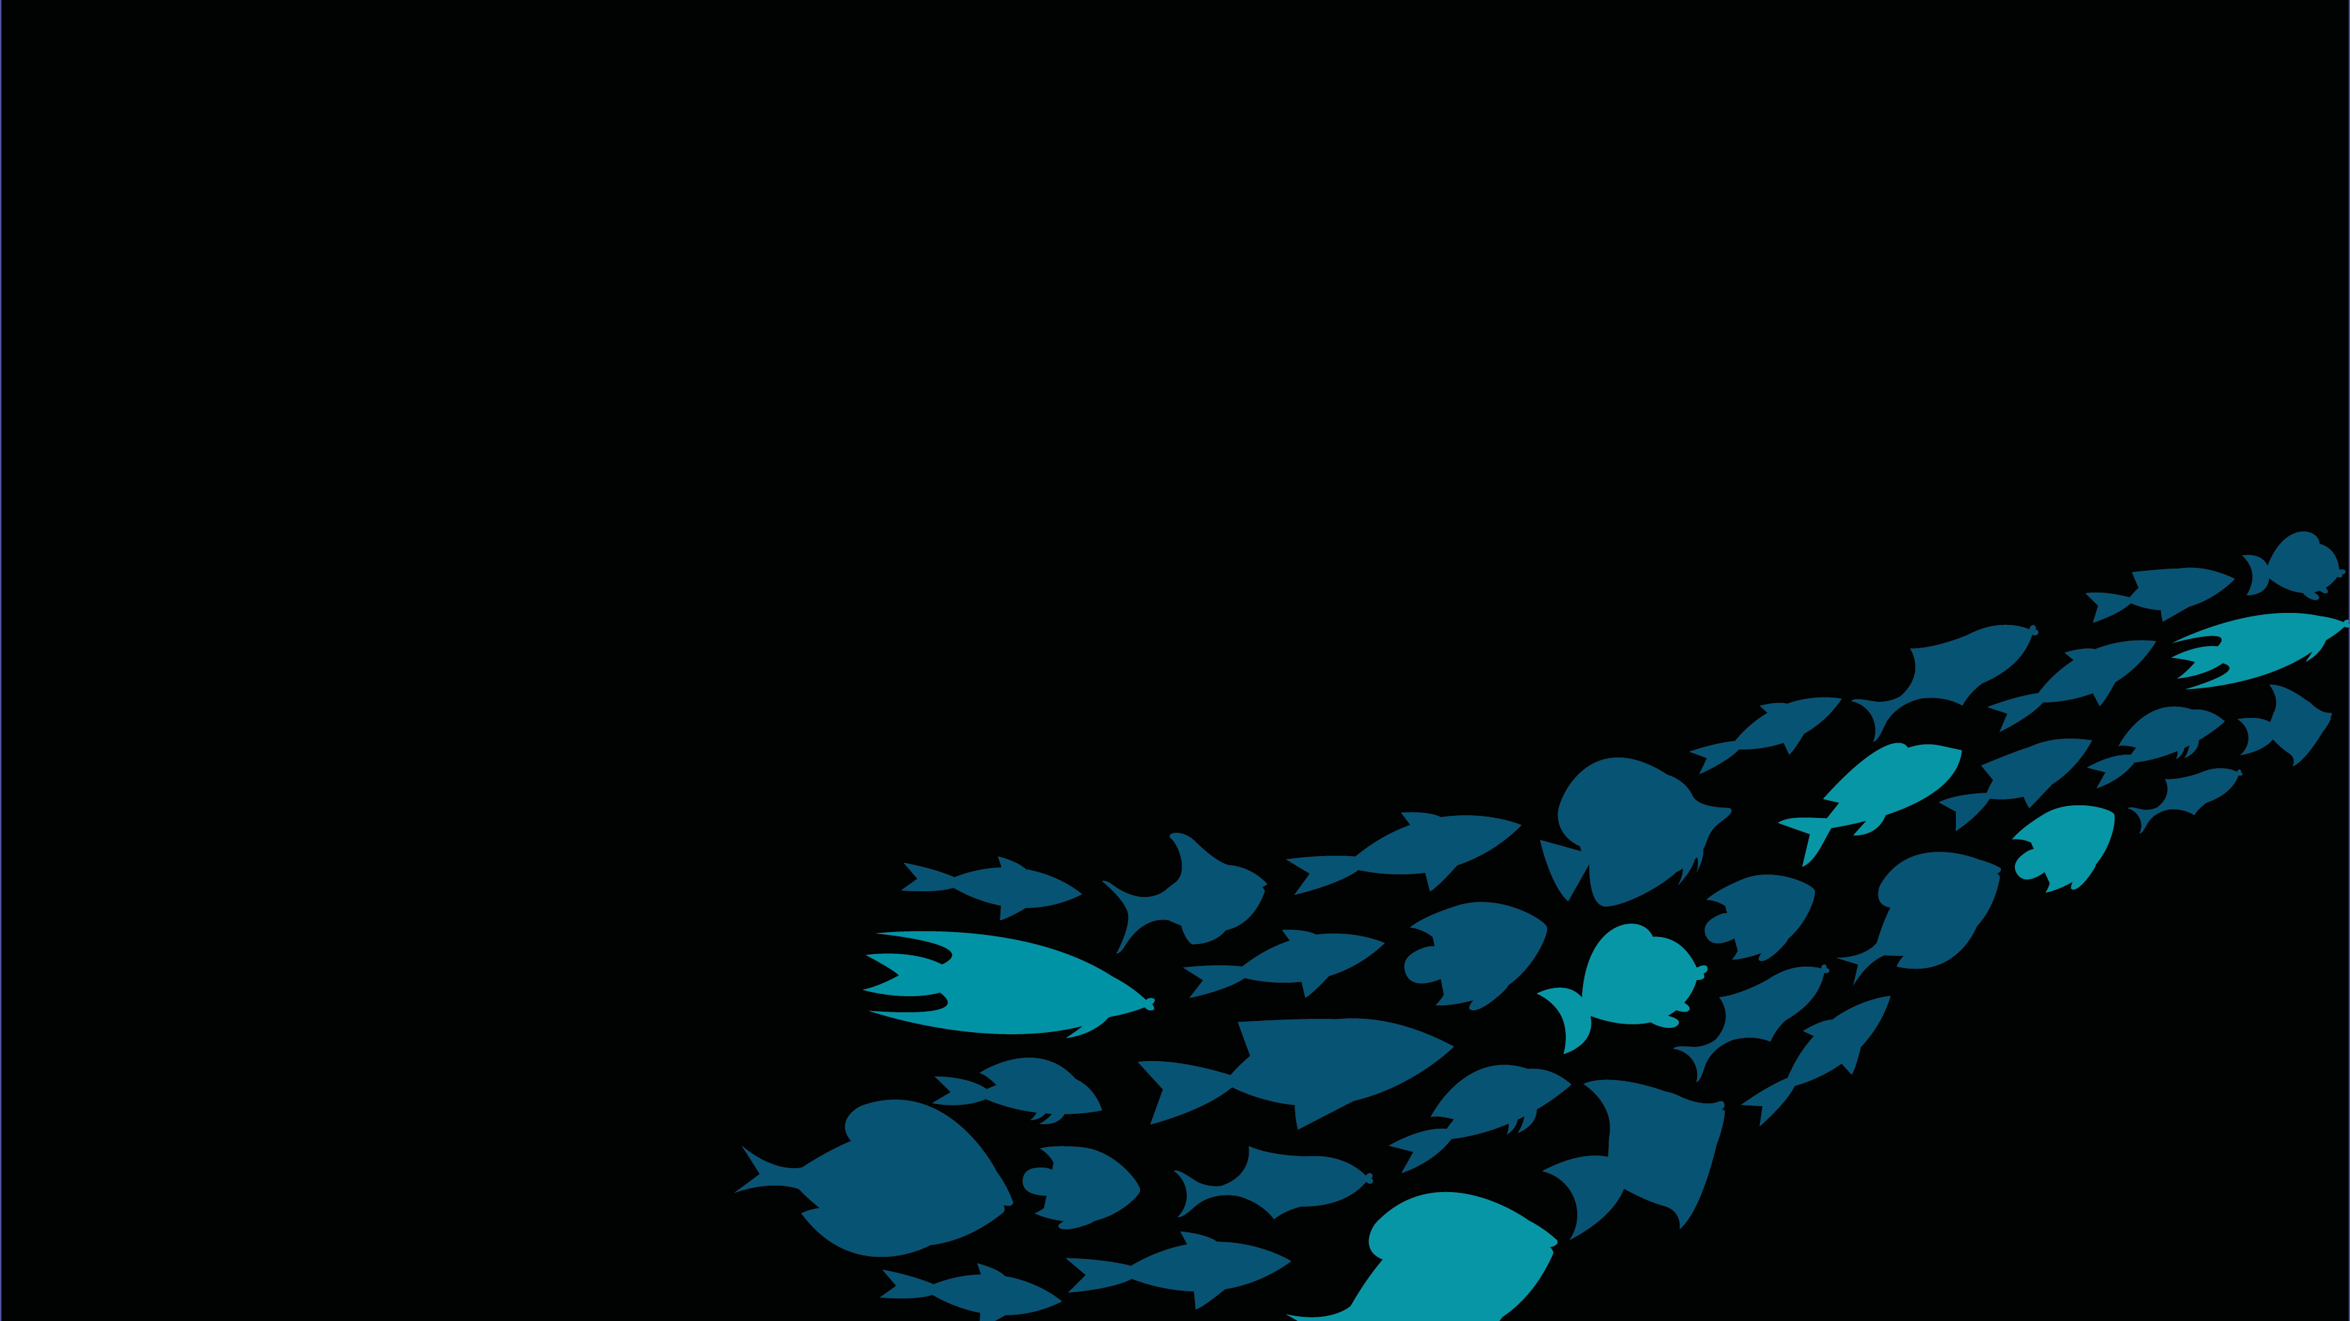
Fish & Fishing Must Share Responsibility To Act
Reinforce commitments made
Rise to the climate crisis
Restore ocean ecosystem health

Slide 4
Reinforce Commitments Made
Implement existing EU laws
eg. Common Fisheries Policy, Marine Strategic Framework Directive
Enforce the ‘Do no harm’ Principle

Slide 5

Rise to the Climate Crisis
Restore fish populations & include climate buffers
Boost marine carbon storage, coastal protection, & increase resilience by restoring valuable habitats
Reduce CO₂ emissions by removing fuel tax subsidies
Recognise ending destructive overfishing as climate action

Slide 6
Restore Ocean Ecosystem Health
Establish trawl-free zones
Commit to ambitious ocean protection >30%
Incorporate scientific advice for ecosystem and climate indicators
Implement recovery measures for collapsed fish populations
Drastically improve monitoring & control of all fishing

Slide 7
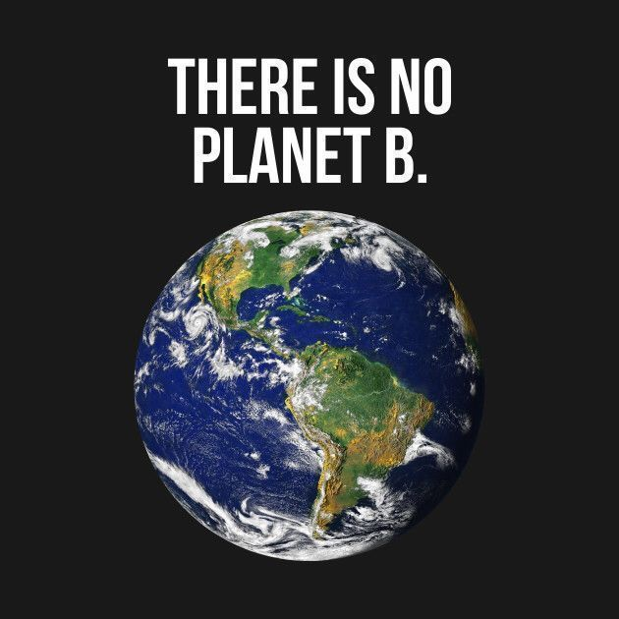

Slide 8
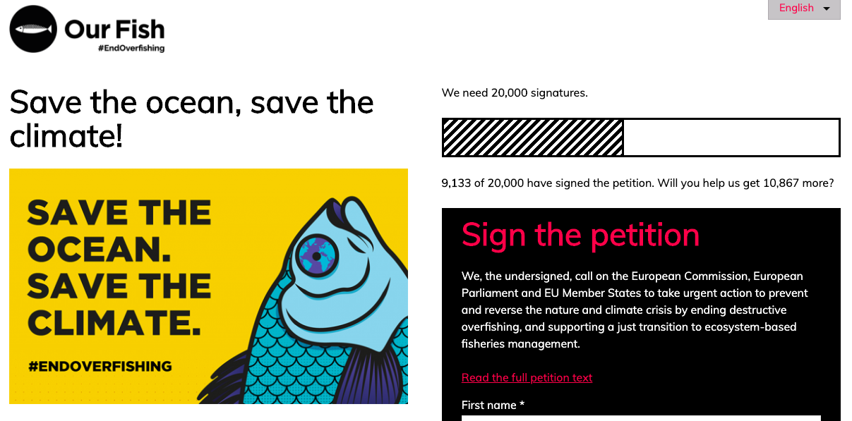


www.save.our.fish
our_fish ourfisheu

