Slide 1
The fundamental role of the Ocean
Karina von Schuckmann
Mercator Ocean international
Chair of the Copernicus Marine Service Ocean State Report
Member of the European Academy of Sciences
Lead author of IPCC AR6 (SROCC, WG1)

Slide 2
von Schuckmann, K., E. Holland, P. Haugan, P. Thomson, 2020, accepted in Journal of Marine Policy

Slide 3
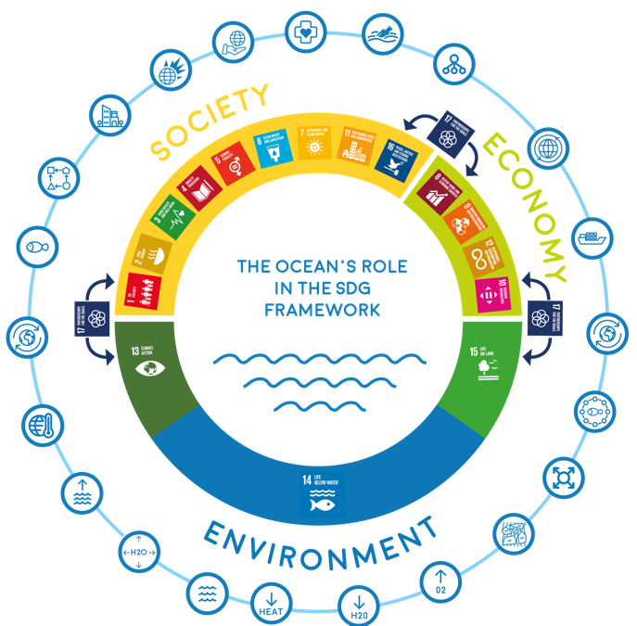
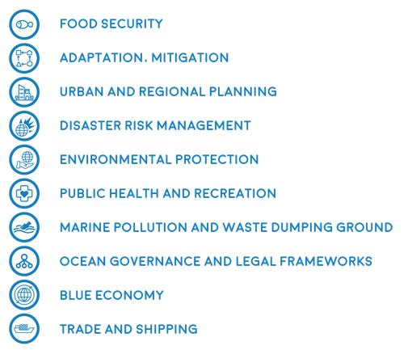
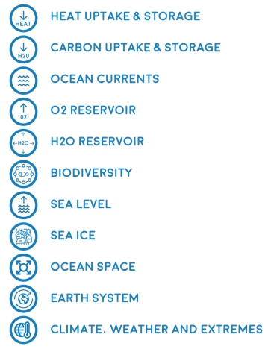
The fundamental role of the Ocean
THE WORLD OCEAN DRIVES GLOBAL SYSTEMS AND PLAYS A FUNDAMENTAL ROLE IN THE SDG FRAMEWORK
von Schuckmann, K., E. Holland, P. Haugan, P. Thomson, 2020, accepted in Journal of Marine Policy

Slide 4

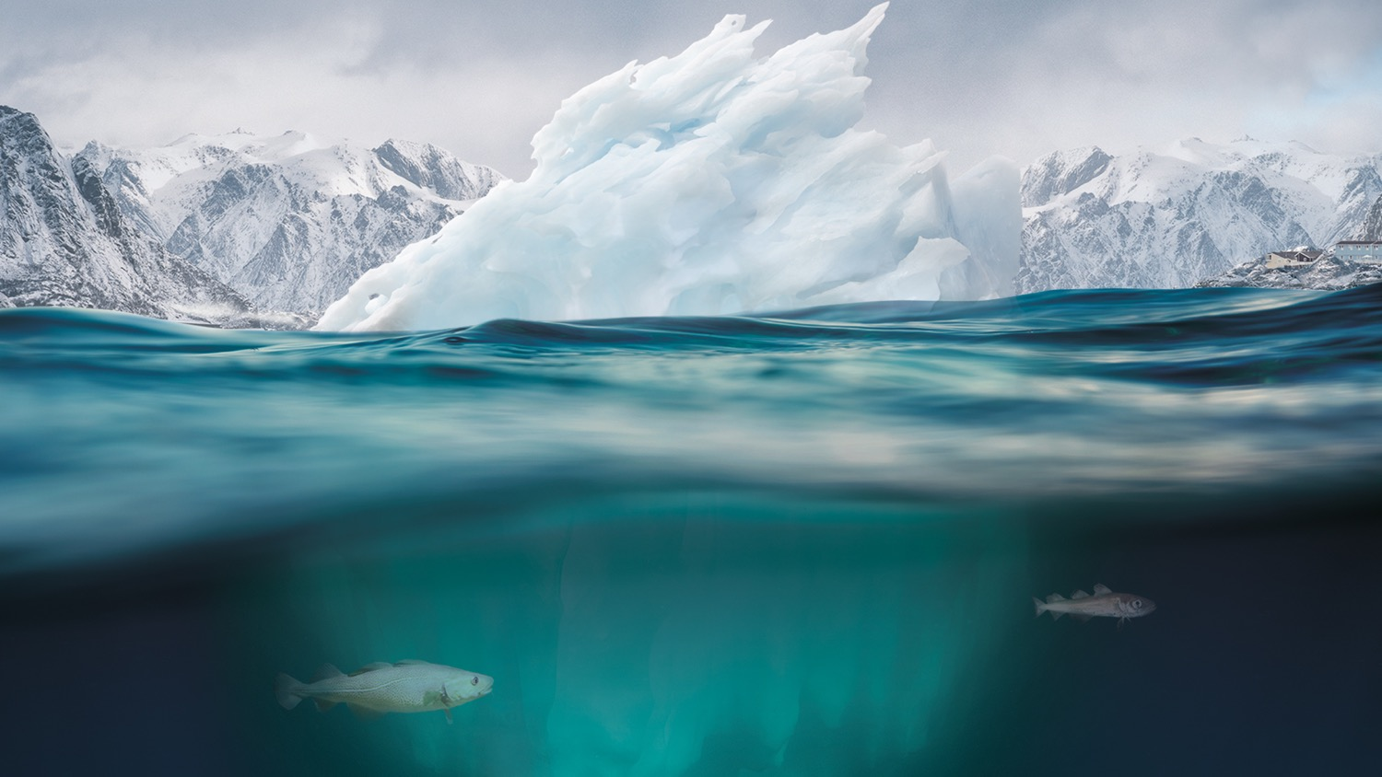

#SROCC
The Ocean and Cryosphere
in a Changing Climate
Oceanographic changes: Ocean warming, sea level rise, ocean acidification and ocean deoxygenation

Slide 5

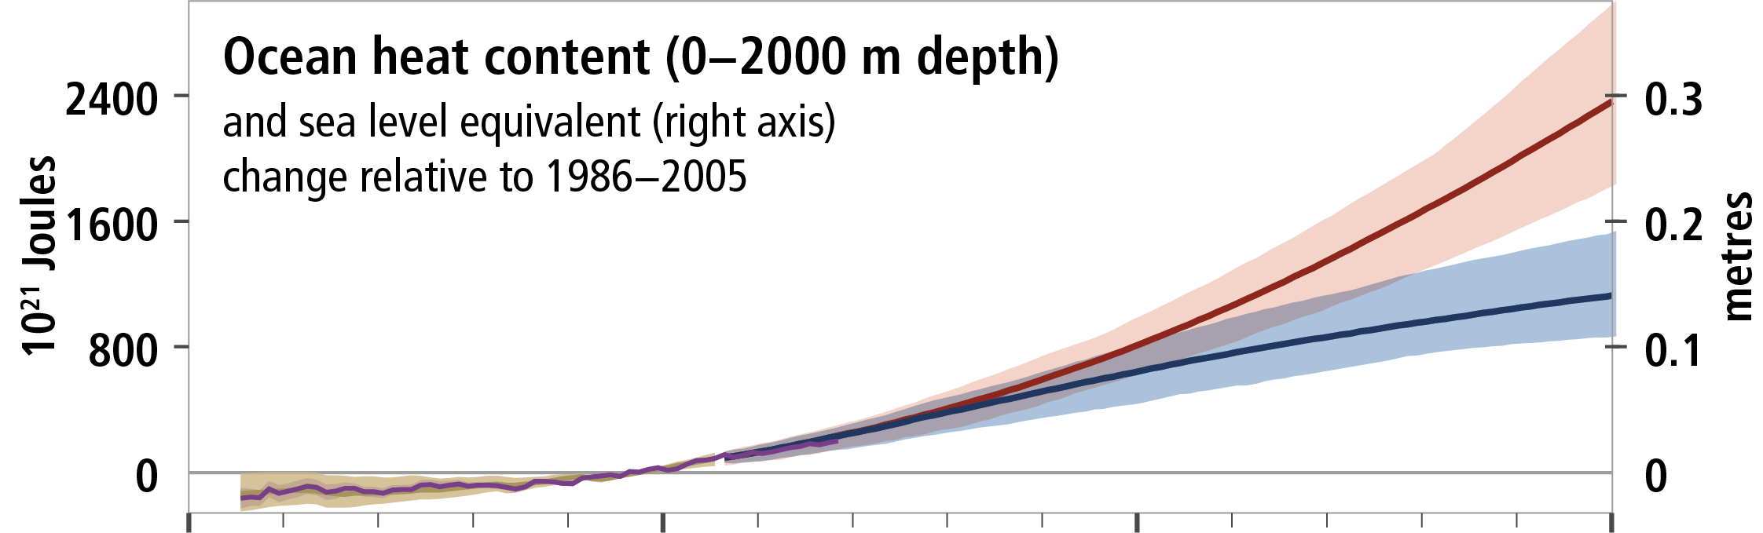


Ocean warming
Due to emissions of heat-trapping gases resulting from human activities, the global ocean has warmed as it has taken up more than 90% of the excess heat in the climate system, making climate change irreversible.
  High greenhouse gas emission scenario in the absence of policies to combat climate change (RCP8.5).
  2081-2100 temperature = +4.3ºC (±1.1ºC)
  2081-2100 CO₂ concentration = 850 ppm
10²¹ Joules
  Low greenhouse gas emission scenario, with high mitigation (RCP2.6).
  Gives a 2 in 3 chance of limiting warming to below 2ºC by 2100.
  2081-2100 temperature = +1.6ºC (±0.7ºC)
  2081-2100 CO₂ concentration = 426 ppm
Meters
1950
2000
2050
2100
Ocean warming is continuing unabated. Since the last three decades, the rate of ocean warming has increased and around half of the total heat gain in the global ocean has occurred in the Southern Ocean in the last decade.
The ocean will continue to warm throughout the 21st century. By 2100, the ocean will take up 2 to 4 times more heat if global warming is limited to 2°C and up to 5 to 7 times at higher emissions.

Slide 6


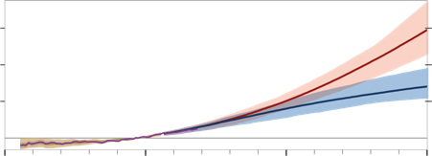
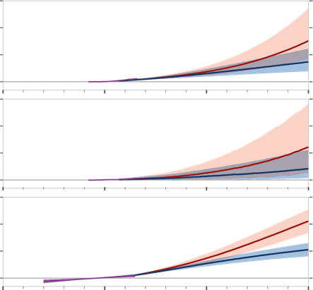

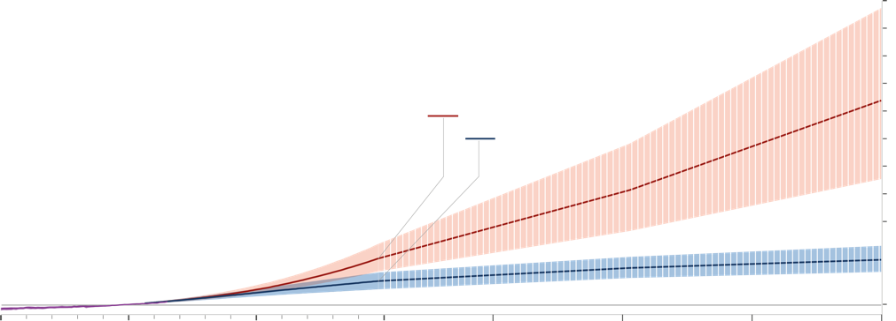
Sea level rise
Historical (observed)
Metres
0.3
Greenland
ice sheet mass loss
Ocean heat content (0−2000 m depth)
as 10²¹ Joules (right axis)
2400
Historical (modelled)
0.2
1600
Projected (RCP2.6)
0.1
800
Projected (RCP8.5)
0
1950
2000
2050
0
Values as sea level equivalent
Changes relative to 1986–2005
Metres
0.3
Antarctic
ice sheet mass loss
2100
0.2
Primary drivers
0.1
5
0
Global mean sea level
Metres
0.3
Glacier
mass loss
0.84 m
4
0.2
0.43 m
0.1
3
0
Metres
2
1
1950
2000
2050
2100
2150
2200
2250
0
2300
During the 20th century, the global mean sea level rose by about 15cm. Sea level is currently rising more than twice as fast and will further accelerate reaching up to 1.10 m in 2100 if emissions are not sharply reduced.
There is no scenario that stops sea level rise this century. We have the choice between below 1 metre and up to several metres of sea level rise by 2300
Notes:
Metres SLR by 2300 due to:
Thermal expansion
Glacier melt
Ice sheet melt

Slide 7
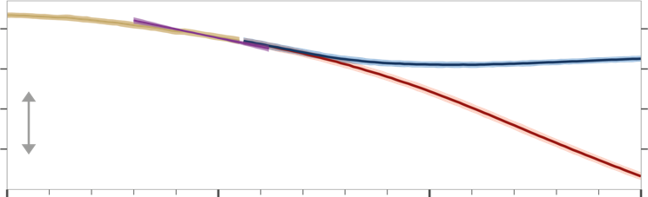
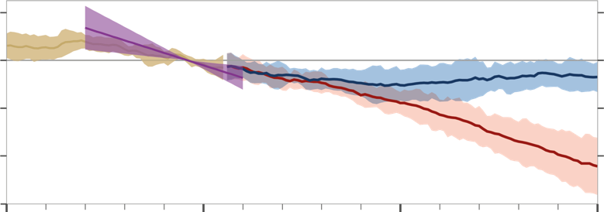
Ocean acidification
The ocean has taken up 20-30% of the global emissions from human activities over the past 3 decades.
Historical (observed)
8.1
pH
Surface pH
8.0
Historical (modelled)
Projected (RCP2.6)
7.9
Projected (RCP8.5)
7.8
1950
2000
2050
2100
As a consequence of anthropogenic carbon uptake, the ocean has undergone increasing surface acidification and continued carbon uptake by the ocean by 2100 is virtually certain to exacerbate ocean acidification.
Ocean deoxygenation
A loss of oxygen has occurred from the surface to 1000 m
Ocean oxygen is projected to further decline over the 21st century.
2
0
Ocean oxygen
–2
%
–4
–6

Slide 8
The Ocean provides a guide for the future

Slide 9
Thank you !
Any questions ?
karina.von.schuckmann@mercator-ocean.fr
https://marine.copernicus.eu/science-learning/ocean-state-report/

